Slide 1
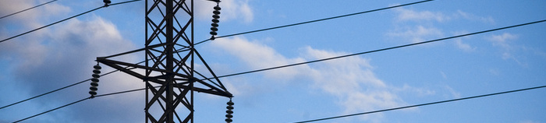
The national grid
AQA: P1

Slide 2
Starter
Where is electricity generated?
How are fossil fuels created?
What type of energy is stored in a fossil fuel?
What is the purpose of the fossil fuel in a power station?
Explain how the generator is turned in a fossil fuel fired power station

Slide 3
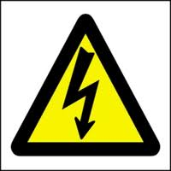
Today’s objective
To understand how the National Grid is used to transport electricity around the country
To succeed
State how electricity is transported
around the country
State the different parts of the
National Grid and explain their functions
Analyse the pros of using step up and step
down transformers

Slide 4
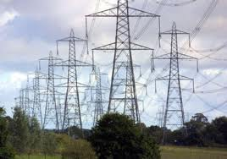
The national grid
The National Grid is a system of cables and transformers linking power stations to consumers
Electricity is generated
at power stations and
distributed around the UK
through a vast circuit
of electrical cabling
Notes:
Set up in 1926 (UK) at 240V supply. Before this, every town had it’s OWN power station. The set up had different voltages in each town. This meant that if a neighbouring town had a high demand for electricity, other towns couldn’t help out because of the differences in voltage. In 1994 the standard 230V was decided by government

Slide 5
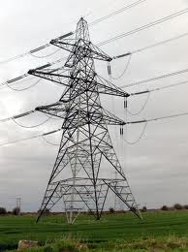
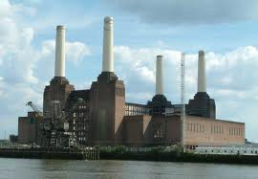

Transporting electricity
Step-Up Transformer
Step-Down Transformer
This is how our
National Grid
Works!!

Slide 6
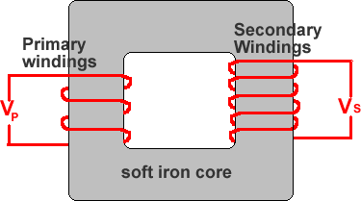
What is a step up transformer?

Slide 7
A step up transformer has more turns on the
output than on the input.
This means that the output voltage, the voltage
in the cables is increased.
How does this help?

Slide 8
Transformers are very efficient and so little
power is lost
Input power = current _{high} X voltage_{low}
Output power = input power
Output power = current_{low} X voltage _{high}

Slide 9
If the voltage in the cables is high, the current
in the cables is low
P = IV
Using Ohm’s Law, V = IR, substitute for V
P = I² R
This is an equation you need to know

Slide 10
Energy dissipated as heat in the cables
depends on the square of the current and
so if we keep the current low, less energy will
be lost in transmission and therefore the use
of high voltage power lines is the most efficient way
of sending electrical energy

Slide 11
So what difference does this high voltage make?
1.26
150A
28350W

Slide 12
79%
1.5A
2.835W
0.07%

Slide 13


How are transformers used to supply electricity?

Slide 14
But there are problems ..

Slide 15
https://www.youtube.com/watch?v=JMKqiDU4Vbs

Slide 16
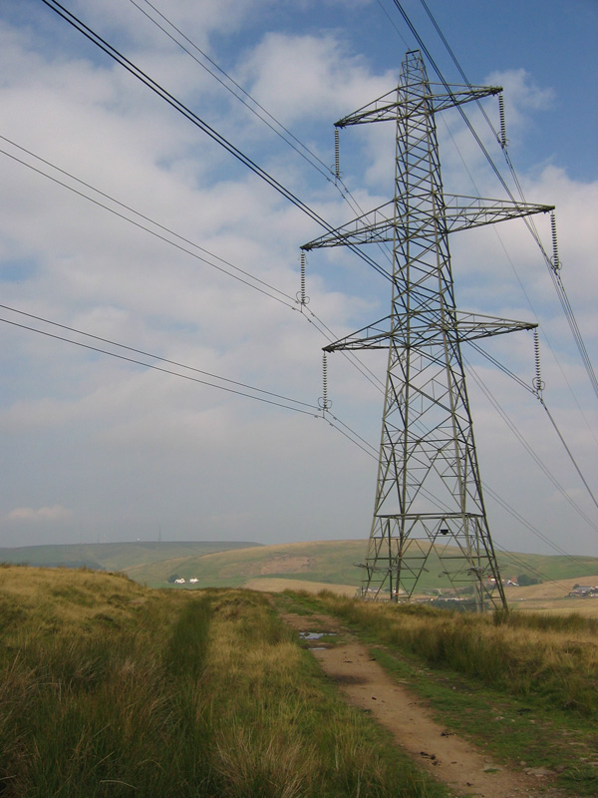
What are the advantages and drawbacks of overhead cabling?
Notes:
We don’t bury many electric cables underground. Can you think why not?
More expensive
More difficult to repair
Difficult to bury when they cross canals, rivers, roads etc
Show kite video

Slide 17


Slide 18
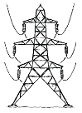
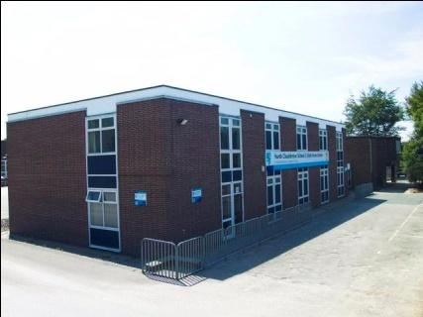
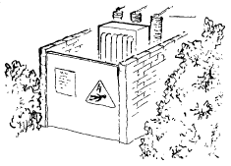
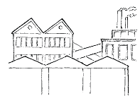

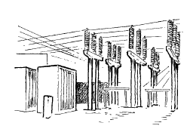
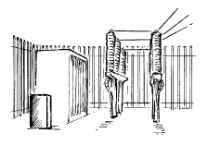
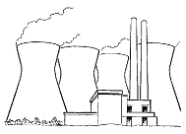
Cut out the pictures
Arrange them into a diagram of the National Grid
Draw cables using a marker/pen and a ruler
Label what is happening at each stage

