Slide 1
Temperature, heat, internal energy and change of state

Slide 2
Objectives
To understand the difference between heat energy and temperature
To appreciate that the internal energy of an object is the sum of the kinetic
and potential energies of the particles
To be able to explain what happens when a solid is heated up to its boiling
point
To be able to explain how the melting point of a material depends on the
forces between the particles

Slide 3
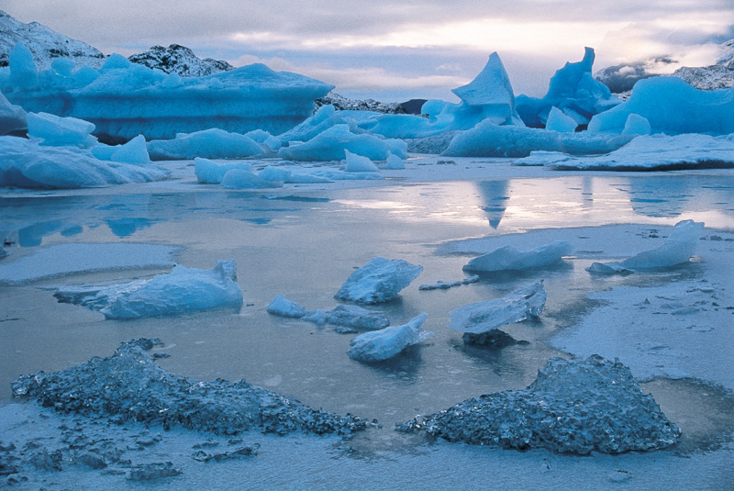

What’s the temperature?
The coldest place on Earth is Antartica, where temperatures as cold as -89˚C have been recorded. At the other extreme, the hottest place on Earth is the El Alzizia desert in Libya where temperatures have soared to 58˚C.
But what exactly do we mean by hot and cold?

Slide 4
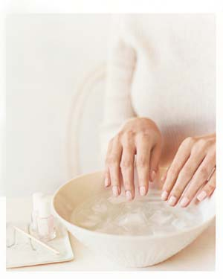
Can you trust your senses?
Try holding one hand in hot water and the other in cold water. Then put them both into warm water. You’ll probably find something strange. The cold hand senses the water as warmer, while the hot hand, feels it colder. We can’t always trust our senses, which is why we use thermometers.

Slide 5
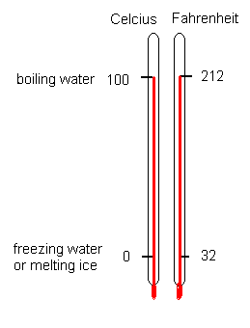
The Celcius temperature scale
We measure temperature to tell us exactly how hot or cold something is. To do this we use a thermometer, which has a scale on it. The celcius temperature scale is based on two fixed points, the melting point of ice (water) and the boiling point of water at normal atmospheric pressure. The melting point of water is called 0, and the boiling point is called 100. There are 100 divisions or degrees between these two points.

Slide 6
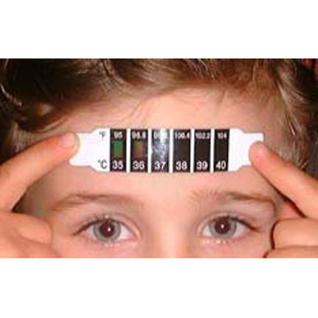
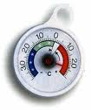
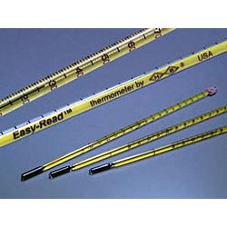
The right thermometer for the job
There are different thermometers for different jobs. For example, your body temperature is 37˚C but the temperature in a freezer might be -20˚C. You need different thermometers to measure a range of temperatures, from the hottest to the coldest on its scale

Slide 7
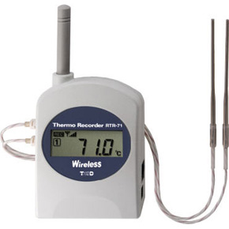
In science we need to choose the correct thermometer for the experiment we are doing.
The resolution of the thermometers we use regularly is 1⁰C. –but there are thermometers that read only up to 50⁰C but will have a better resolution
A temperature sensor and datalogger can be very useful if many
readings need to be taken and the results can be displayed on a
computer in graph form straight away.

Slide 8
The temperature of a object is a measure of the average kinetic energy of the
particles in the object.
To raise the temperature of an object we have to supply heat energy to it.

Slide 9
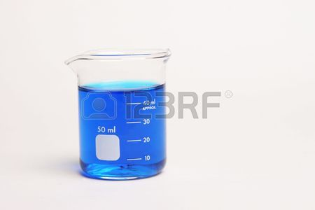
How much energy is in this beaker of water?
We need to add up the energies of all the
particles in the water.
The particles have random kinetic energy as they are moving about all over the place
The particles also have potential energy because of the forces between the particles
If we add up all the energies for all the particles, we have the internal energy
of the liquid.

Slide 10
How are temperature and heat energy different?
The liquids in these 2 beakers are at the same temperature, so the particles have the same average speed.
2 Beakers of water at 50°C are at the same temperature but if one is twice as big as the other, it will contain twice as much heat energy as the other.
A
B
50°C
1 litre
2 litres

Slide 11
Which object…
Bath full of warm water
Lit sparkler
Cup of freshly made tea
Has the most heat energy?
Has the highest temperature?

Slide 12
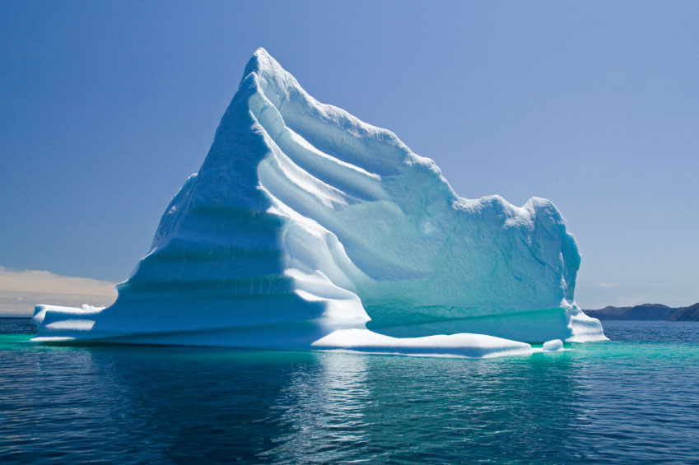

Which has the most internal energy, the iceberg or the firework?

Slide 13
Changing internal energy
Changing state is a physical change- the number of particles
does not change

Slide 14
http://www.bgfl.org/bgfl/custom/resources_ftp/client_ftp/ks3/science/changing_matter/index.htm

Slide 15
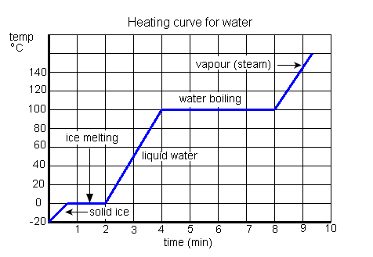
F
D
E
B
C
A

Slide 16
From A to B:
The ice is below 0⁰C- heating increases the average kinetic energy of the
particles and the temperature rises

Slide 17
Graph to show how the temperature of ice changes as it is gently heated
Is it a solid, liquid or gas?
For the ice to change into water the strong forces holding the particles together have to be broken.
This part of the graph is a flat line. It shows that even though the ice is still being heated, it stays as ice for 3 minutes.
100
A gas
90
80
Why does the ice not change into a liquid straight away?
Heat
70
60
Is it a solid, liquid or gas?
This requires a lot of energy.
Temperature (°C)
A liquid
50
40
30
20
10
0
2
3
4
5
6
-10
1 2 3 4 5 6 7 8 9 10 11 12 13 14 15 16
-20
A solid
The heat being supplied to the ice during these three minutes is getting used up breaking the bonds between the particles.
Is it a solid, liquid or gas?
Time (minutes)

Slide 18
Between B and C:
This is the melting point
The temperature is not rising and so the average kinetic energy of the
particles is not changing.
The energy supplied is used to increase the potential energy of the
system.
The attractive forces between the particles are weakened and so
the particles can now slide over each other.

Slide 19
Between C and D:
The substance is now a liquid.
The temperature is rising which means that the energy supplied
is increasing the average kinetic energy of the particles.
As the temperature of the liquid rises more particles will have enough
energy to leave the surface.-this is evaporation

Slide 20
Between D and E: The liquid is boiling
The temperature is not rising. The average kinetic energy of the
particles is not increasing.
All the energy supplied is being used to increase the potential
energy of the system.
The energy is being used to break the bonds between the particles

Slide 21
Between E and F: the substance is now a gas
The temperature of the gas is rising, so the average kinetic
energy of the particles in the gas is increasing.

Slide 22
If we need energy to change a solid into a liquid,
what do you think happens when a liquid turns
back into a solid?

Slide 23
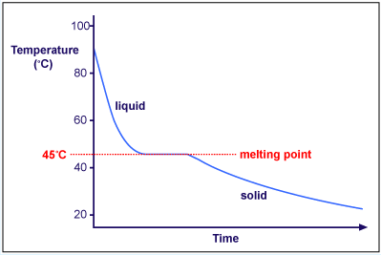

Slide 24
Name |  | Molecular Formula |  | Melting Point (ºC) |  | Boiling Point (ºC) |  | State at 25ºC
methane |  | CH₄ |  | -183 |  | -164 |  | gas
ethane |  | C₂H₆ |  | -183 |  | -89
propane |  | C₃H₈ |  | -190 |  | -42
butane |  | C₄H₁₀ |  | -138 |  | -0.5
pentane |  | C₅H₁₂ |  | -130 |  | 36
hexane |  | C₆H₁₄ |  | -95 |  | 69
heptane |  | C₇H₁₆ |  | -91 |  | 98
octane |  | C₈H₁₈ |  | -57 |  | 125
nonane |  | C₉H₂₀ |  | -51 |  | 151 |  | liquid
decane |  | C₁₀H₂₂ |  | -30 |  | 174
undecane |  | C₁₁H₂₄ |  | -25 |  | 196
dodecane |  | C₁₂H₂₆ |  | -10 |  | 216
eicosane |  | C₂₀H₄₂ |  | 37 |  | 343
triacontane |  | C₃₀H₆₂ |  | 66 |  | 450 |  | solid

