Slide 1
Starter
Read pg. 116 and answer question 4 on your worksheet.

Slide 2
L5: Enzymes
Learning Objectives:
Describe the structure and function of enzymes.
Describe the lock and key model of enzyme action.
Describe the optimum conditions that allow enzymes to work best.
Explain the role of bile in the digestive system.
Explain why enzymes become denatured under certain conditions.

Slide 3
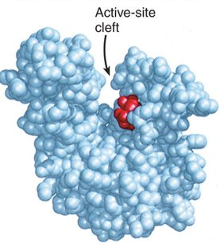
Enzyme Structure
Enzymes are large proteins (chain of amino acids).
They are folded into a unique shape forming an active site.
Only the substrate (substance involved in the reaction being catalyzed) fits and binds to the active site.

Slide 4
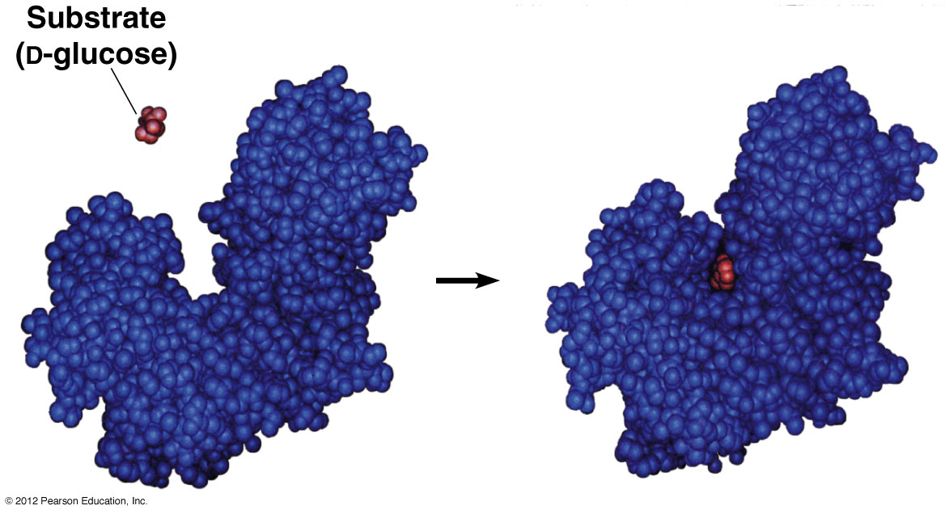

Slide 5
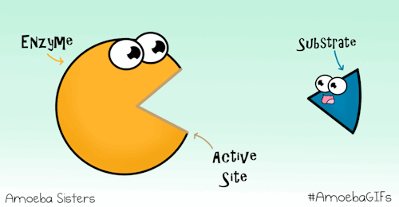

Slide 6
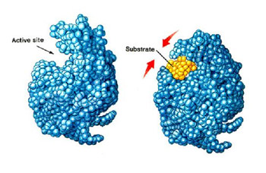
Lock and Key Theory
Once the substrate (key) binds to the active site (lock) it changes the shape of the protein slightly.
The substrate interacts with the protein, speeding up the chemical reaction.

Slide 7
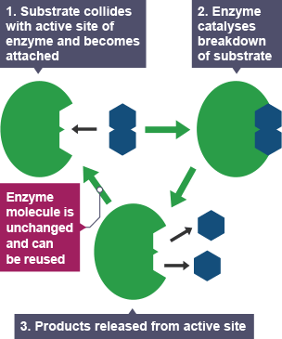
The products of the reaction are then released from the active site as they no longer fit.
The enzyme molecule is unchanged and can be used again.

Slide 8
L3: Digestive System (Part 2)
Learning Objectives:
Describe the structure and function of enzymes.
Describe the lock and key model of enzyme action.
Describe the optimum conditions that allow enzymes to work best.
Explain the role of bile in the digestive system.
Explain why enzymes become denatured under certain conditions.

Slide 9
Optimum Conditions
What conditions will affect enzyme function? How?
Temperature
pH
Under optimum conditions, enzymes work best and the rate of reaction is fastest.

Slide 10
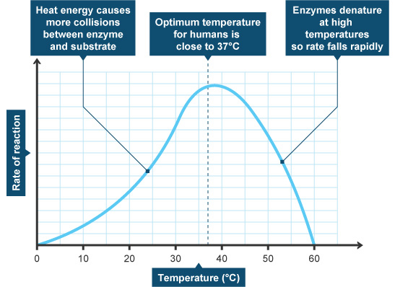
Effect of Temperature

Slide 11
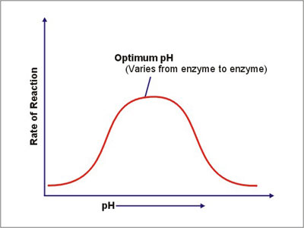
Effect of pH

Slide 12
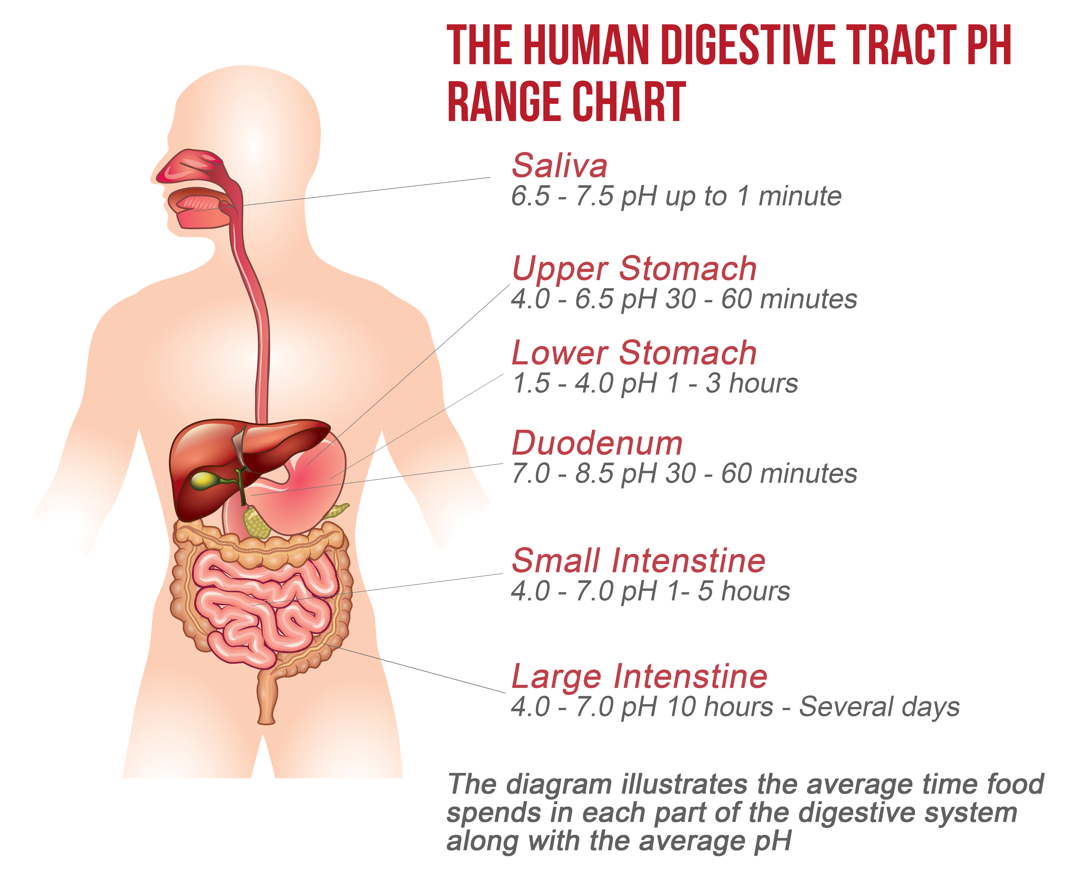

Slide 13
L3: Digestive System (Part 2)
Learning Objectives:
Describe the structure and function of enzymes.
Describe the lock and key model of enzyme action.
Describe the optimum conditions that allow enzymes to work best.
Explain the role of bile in the digestive system.
Explain why enzymes become denatured under certain conditions.

Slide 14
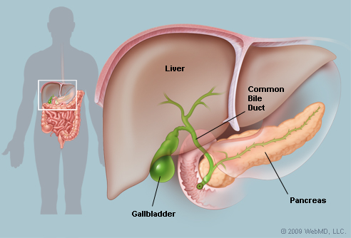
Bile
Produced in the liver
Stored in the gall bladder
Bile is alkaline and neutralises the hydrochloric acid produced in the stomach.
This allows the enzymes in the small intestine to function under optimum pH conditions.
Released into the small intestine

Slide 15
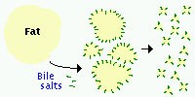
It also emulsifies lipids into smaller droplets.
This increases the surface area where enzymes can attach to the substrate.
This also speeds up the rate of reaction for digestion.

Slide 16
L3: Digestive System (Part 2)
Learning Objectives:
Describe the structure and function of enzymes.
Describe the lock and key model of enzyme action.
Describe the optimum conditions that allow enzymes to work best.
Explain the role of bile in the digestive system.
Explain why enzymes become denatured under certain conditions.

Slide 17
Enzymes can become Denatured

Slide 18
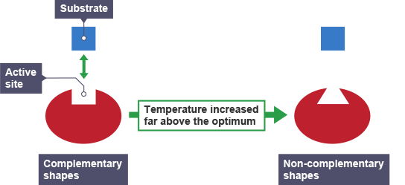
denatured

Slide 19
L3: Digestive System (Part 2)
Learning Objectives:
Describe the structure and function of enzymes.
Describe the lock and key model of enzyme action.
Describe the optimum conditions that allow enzymes to work best.
Explain the role of bile in the digestive system.
Explain why enzymes become denatured under certain conditions.

Slide 20
Homework
Read pg. 70 – 81.

Slide 21
BBC Bitesize - Enzymes

