Slide 1
Why can you smell something that is across the room?

Slide 2
Lesson 6 – Diffusion
Learning Objectives:
Describe diffusion as the spreading out of particles resulting in a net movement of particles from areas of high to low concentration.
Explain the factors affecting the rate of diffusion including:
Concentration
Temperature
Surface area
Analyse the role of diffusion in the exchange of materials in cells and how cells are adapted for exchange.
Calculate and compare surface area to volume ratios.

Slide 3
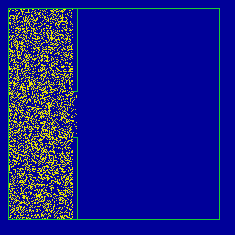
Diffusion
Watch the animation and come up with a definition for diffusion. Include the term “particles” in your definition.

Slide 4
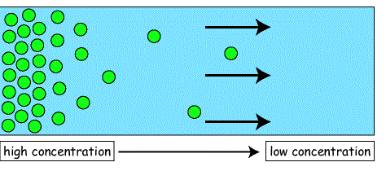
Diffusion
Diffusion is the spreading out of particles resulting in a net movement of particles from high to low concentration.

Slide 5
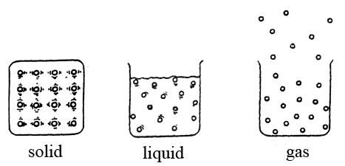
A little bit about particles
Particles are always moving randomly.
Solid particles vibrate, but are fixed in place. Solid particles CANNOT diffuse.
Liquid particles have more energy and are able to move past each other. Liquid particles are able to diffuse.
Gas particles have the most energy, move very quickly, and are able spread far apart. Gas particles diffuse the fastest.

Slide 6
Diffusion
http://highered.mheducation.com/sites/0072495855/student_view0/chapter2/animation__how_diffusion_works.html

Slide 7
What factors affect the rate of diffusion?
Diffusion happens at different speeds.
We are going to investigate how three different factors affect the rate (speed) of diffusion.
Temperature
Surface Area
Steepness of Concentration Gradient

Slide 8
Demo – Temperature
Watch the demo.
Describe the effect of temperature on the rate of diffusion.
Notes:
Demo – food colouring in three beakers; cold, medium, and hot water.

Slide 9
Practical – Investigating Effect of Surface Area on Rate of Diffusion
Agar blocks made with an indicator and alkali will turn colourless when acid diffuse into the block.
We are going to time how long it takes for acid to diffuse into the blocks of different sizes.
Notes:
http://www.nuffieldfoundation.org/practical-biology/effect-size-uptake-diffusion
Technician notes: https://www.youtube.com/watch?v=Xs_ilcbtbq8

Slide 10
Thinking about the practical
https://www.youtube.com/watch?v=xuG4ZZ1GbzI
Watch the video and answer the following question.
Why is it that cells cannot be too large? Why is surface are to volume ratio important?
Notes:
A single-celled organism has a relatively large surface area to volume ratio. This allows sufficient transport of molecules into and out of the cell to meet the needs of the organism.
If the surface area to volume ratio is too low, diffusion is too slow to meet the needs of the cell for new materials and removal of waste.

Slide 11
Demo – Effect of Concentration Gradient
The difference in concentrations between two areas is called the concentration gradient.
The larger the difference in concentrations, the steeper the concentration gradient.
Watch the demo and describe the effect of the steepness of the concentration gradient on the rate of diffusion.
Notes:
Agar jelly with cubes of the same size using warm hydrochloric acid of different concentrations.

Slide 12
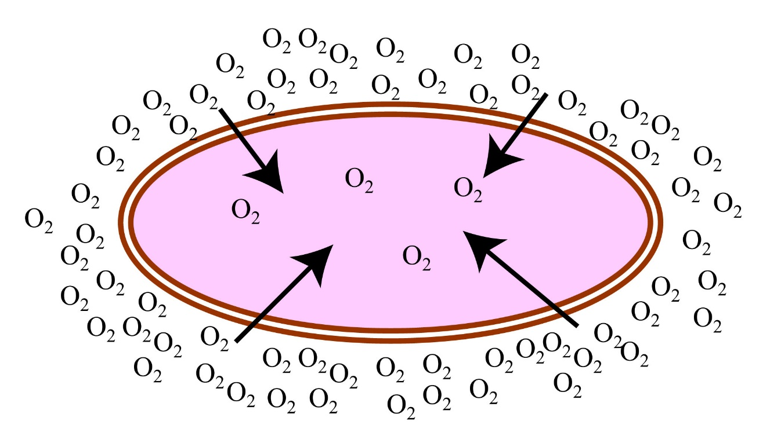
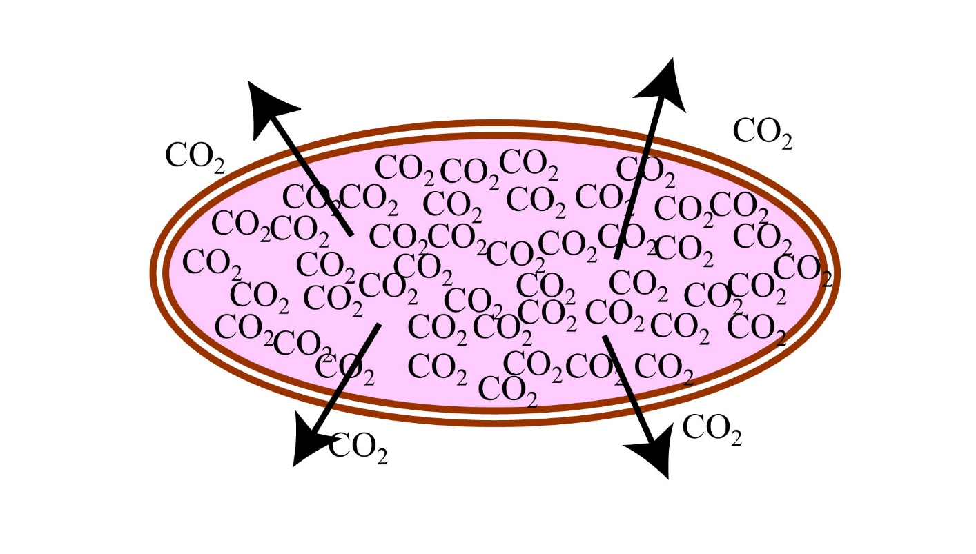
Why is diffusion important to cells?
Cells get materials they need (such as oxygen) and removing waste (such as carbon dioxide and urea) by diffusion through the cell membrane.

Slide 13
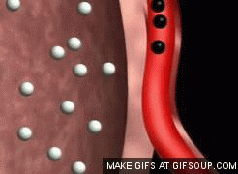
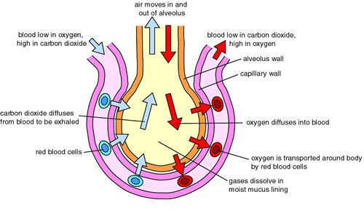
Examples of Diffusion: Gas Exchange
Gas exchange happens in the lungs and gills (in fish).
Low Oxygen
High CO₂
High Oxygen Low CO₂

Slide 14
Adaptations for Diffusion
The effectiveness of an exchange surface is increased by:
• having a large surface area
• a membrane that is thin, to provide a short diffusion path
• (in animals) having an efficient blood supply
• (in animals, for gaseous exchange) being ventilated (breathing).

Slide 15
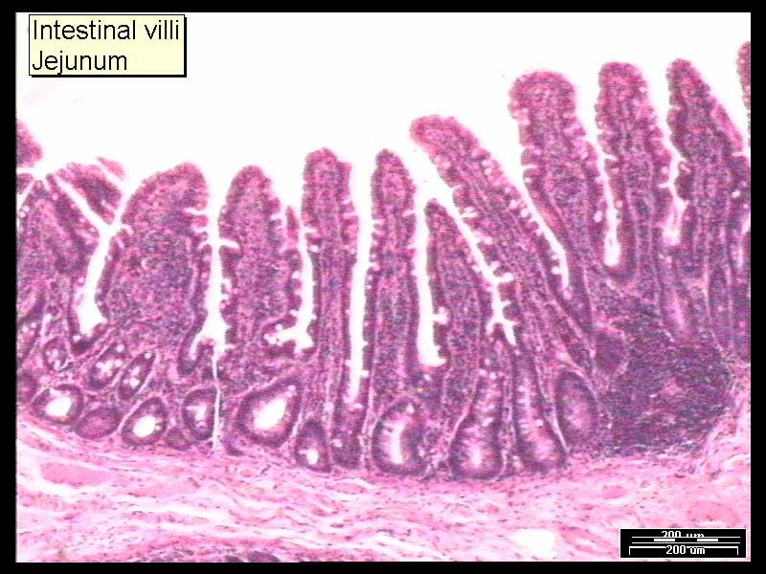
Specialisation for Exchange: Small Intestine (Villi)
Folds (villi) create a larger surface area to volume ratio.
Thin membranes to some nutrients to the bloodstream through diffusion quickly.
Capillaries (blood vessels) quickly pass materials away to maintain concentration gradient.

Slide 16
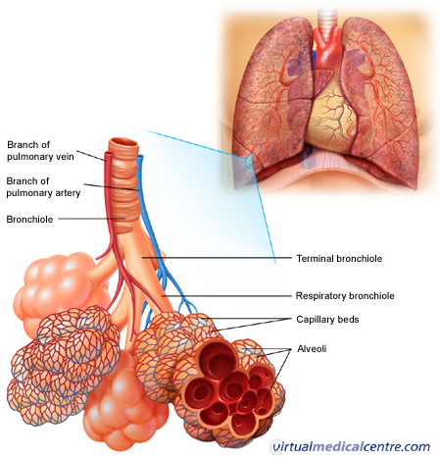
Specialisation for Exchange: Lungs (Alveoli)
Pockets (alveoli) create a larger surface area to volume ratio.
Thin membranes
Network of capillaries

Slide 17
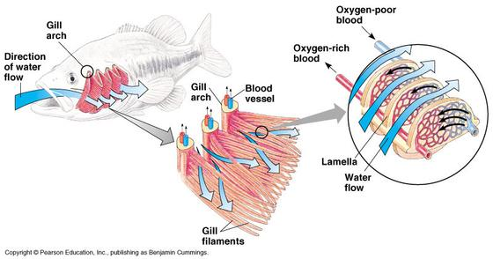
Specialisation for Exchange: Gills
Folds for larger surface area to volume ratio
Thin membranes
Network of capillaries

Slide 18
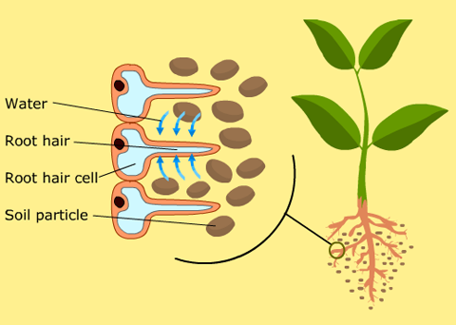
Specialisation for Exchange: Roots (Root Hair Cells)
This projection increases surface area to volume ratio.
Thin membranes
Network of xylem and phloem to transport materials.

