Slide 1
What is happening in this series of pictures?
Why might this be important to organisms?
What do you think needs to happen before this process can occur?
Notes:
Cell division
This is how multicellular organisms grow and repair
Cell needs to grow, increase number of sub cellular structures (ie mitochondria), copy genetic information from DNA

Slide 2
Lesson 3 – Cell Division
Learning Objectives:
Describe how genetic material is stored as molecules of DNA in structures called chromosomes which are found in the nucleus.
Explain how cells divide through mitosis.
Analyse the importance of cell division in the growth and development of multicellular organisms.

Slide 3
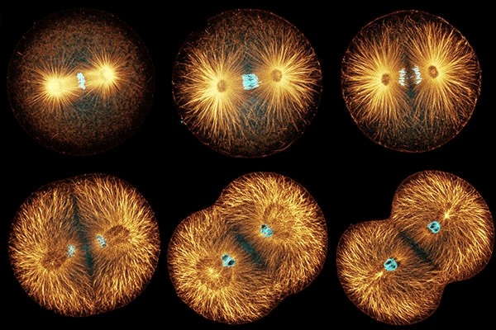
Cell Division
The process of growth and division is called the cell cycle.
Mitosis = stage of the cell cycle, a type of cell division that produces two identical cells
Cells need to divide in order to make new cells for growth, repair, and development.

Slide 4
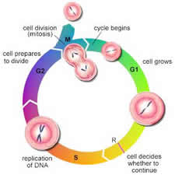
The Cell Cycle
The new cell grows and prepares to divide (when it receives a chemical signal)
Increases the number of sub-cellular structures (such as mitochondria)
Replication (copying) of genetic material (DNA)
Mitosis, the cell separates into two.
Notes:
Note that cells spend most of the their time in interphase (part of the cell cycle that is NOT mitosis)

Slide 5
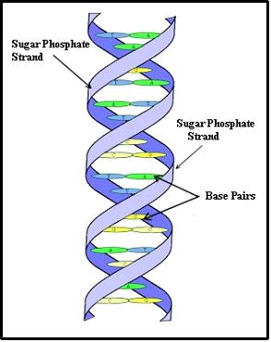
DNA Replication
DNA is the molecule that contains the organism’s genetic information.
Gene = a section of DNA that has instructions for one particular trait (such as eye colour)
DNA needs to be copied, replicated, so that both cells will have a copy of “instructions”.

Slide 6
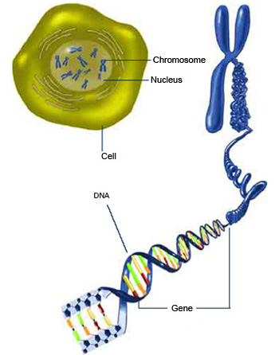
DNA is found as chromosomes in the nucleus
DNA is coiled into a structure called a chromosome. They are usually found in pairs.
Chromosomes contain thousands of genes.
They are found in the nucleus of the cell.

Slide 7
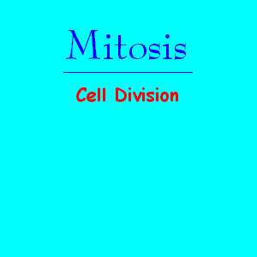
Mitosis – last stage of the cell cycle
Video: Mitosis Time Lapse
Video: Animal vs Bacterial Cell Division
Mitosis occurs after DNA replication creates two sets of chromosomes.
One set of chromosomes is pulled to each end of the cell.
The nucleus then divides.
Finally the cytoplasm and cell membrane divides to form two identical cells.
Notes:
This slide contains an animated GIF of mitosis in great detail.
The video links are videos of actual cells dividing.
NOTE: students DO NOT need to know the different phases of mitosis, only the information in the text of the slide.

Slide 8
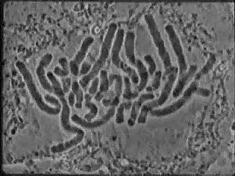
A closer look

Slide 9
Cancer: Cell Division Gone Wrong
Read the article about cancer cells and answer the questions.

