Slide 1
Starter
Under what conditions do ionic compounds conduct electricity?
Why is it they only conduct electricity in these conditions?

Slide 2
L5 Electrolysis of Molten Ionic Compounds
Learning Objectives:
Draw a labelled diagram of equipment needed for electrolysis.
Explain why molten or aqueous ionic compounds conduct electricity.
Describe the process of electrolysis.
Predict the products of electrolysis at each electrode.
Write half equations for the reactions at each electrode.
Explain how electrolysis can be used to extract reactive metals.

Slide 3
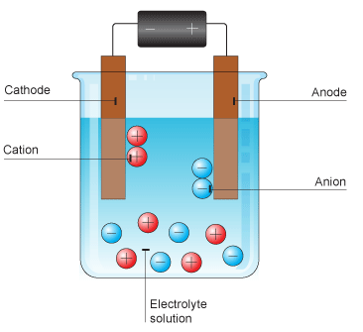
Definitions
Electrolysis = process of breaking down a substance using electricity.
Electrolyte = liquid/solution that conducts electricity (contains the substance to be electrolysed)
Cathode (-) = the negative electrode (cations (+) are attracted to it)
Anode (+) = the positive electrode (anions (-) are attracted to it)

Slide 4
Which is anode? Which is the cathode?
Don’t PANIC!
Positive Anode, Negative Is Cathode

Slide 5
L5 Electrolysis of Molten Ionic Compounds
Learning Objectives:
Draw a labelled diagram of equipment needed for electrolysis.
Explain why molten or aqueous ionic compounds conduct electricity.
Describe the process of electrolysis.
Predict the products of electrolysis at each electrode.
Write half equations for the reactions at each electrode.
Explain how electrolysis can be used to extract reactive metals.

Slide 6
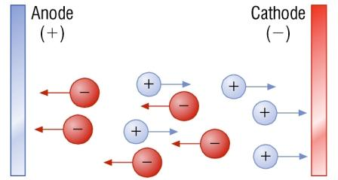
Electrolysis of Molten Compounds
Electrolysis can only be done on molten or aqueous ionic compounds.
Why?
When molten or dissolved the ions are free to move to the electrodes where electrolysis reactions take place.
In solids, the ions are fixed in place and cannot reach the electrodes.
The liquid or solution with mobile ions makes up the electrolyte.

Slide 7
L5 Electrolysis of Molten Ionic Compounds
Learning Objectives:
Draw a labelled diagram of equipment needed for electrolysis.
Explain why molten or aqueous ionic compounds conduct electricity.
Describe the process of electrolysis.
Predict the products of electrolysis at each electrode.
Write half equations for the reactions at each electrode.
Explain how electrolysis can be used to extract reactive metals.

Slide 8
Video: Electrolysis of Molten Compounds
Watch the video and answer the question __ on your worksheet.
https://www.youtube.com/watch?v=cpf9oNRZy-w
What is the electrolyte?
Write observations for the experiment.
How do you know a chemical reaction has taken place?
What happens at the anode? What is produced here?
What happens at the cathode? What is produced here?

Slide 9
Process of Electrolysis
1. When the power source is on, electrons move from the anode towards the cathode.
2a. The positive anode attracts the negative anions.
2b. The negative cathode attracts the positive cations.
Where do the electrons go next?
Electrostatic forces of attraction = opposite charges attract

Slide 10
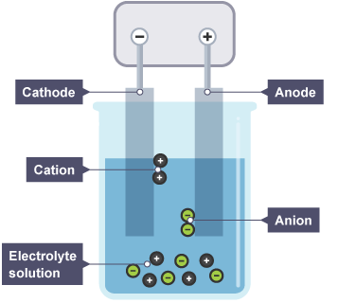
Reactions at the Electrodes
3a. Cathode (-)
Extra electrons build up on the cathode (to make it negative).
When the cations (+) touch the cathode (-) the electrons are transferred to the ion, neutralising it.
M⁺ + e⁻ → M
This produces neutral atoms (elements).

Slide 11
Reactions at the Electrodes
3b. Anode (+)
Extra electrons build up on the cathode (to make it negative).
When the anions (-) touch the anode (+) the electrons are removed from the ion, neutralising it.
M⁻ → M + e⁻
This produces neutral atoms (elements).

Slide 12
L5 Electrolysis of Molten Ionic Compounds
Learning Objectives:
Draw a labelled diagram of equipment needed for electrolysis.
Explain why molten or aqueous ionic compounds conduct electricity.
Describe the process of electrolysis.
Predict the products of electrolysis at each electrode.
Write half equations for the reactions at each electrode.
Explain how electrolysis can be used to extract reactive metals.

Slide 13
Products of Electrolysis of Molten Compounds
Ionic compounds are always made from a metal ion (+) and a non-metal ion (-).
At the cathode (-), pure elemental metal is formed.
At the anode (+), elemental non-metal forms. (e.g. H₂, Br₂, O₂)

Slide 14
Practice
Complete question 7 on your worksheet.

Slide 15
Answers
Ionic Compound | Produced at Cathode | Produced at Anode
Sodium chloride | sodium metal (Na) | chloride gas (Cl₂)
Calcium bromide | calcium metal (Ca) | bromine gas (Br₂)
Zinc (II) oxide | zinc metal (Zn) | oxygen gas (O₂)

Slide 16
L5 Electrolysis of Molten Ionic Compounds
Learning Objectives:
Draw a labelled diagram of equipment needed for electrolysis.
Explain why molten or aqueous ionic compounds conduct electricity.
Describe the process of electrolysis.
Predict the products of electrolysis at each electrode.
Write half equations for the reactions at each electrode.
Explain how electrolysis can be used to extract reactive metals.

Slide 17
Writing half equations for electrolysis
Step 1: write the balanced equation
Al₂O_{3 (l)} → 2Al _{(l)} + 3O_{2 (g)}
Step 2: write out the ions in the ionic compound
2Al³⁺ _{(l)} + 3O²⁻ _{(l)} → 2Al _{(l)} + 3O_{2 (g)}
Step 3: Write two half equations showing electrons
2Al³⁺ _{(l)} + 6e⁻ → 2Al _{(l)}
3O²⁻ _{(l)} → 3O_{2 (g)} + 6e⁻
Half equations need to be balanced for both atoms and electrons.
Which is taking place at the cathode? Which is taking place at the anode?

Slide 18
Writing half equations for electrolysis
Step 1: write the balanced equation
Al₂O_{3 (l)} → 2Al _{(l)} + 3O_{2 (g)}
Step 2: write out the ions in the ionic compound
2Al³⁺ _{(l)} + 3O²⁻ _{(l)} → 2Al _{(l)} + 3O_{2 (g)}
Step 3: Write two half equations showing electrons
2Al³⁺ _{(l)} + 6e⁻ → 2Al _{(l)}
3O²⁻ _{(l)} → 3O_{2 (g)} + 6e⁻
cathode = electrons added
anode = electrons lost

Slide 19
Writing half equations for electrolysis
Step 1: write the balanced equation
Al₂O_{3 (l)} → 2Al _{(l)} + 3O_{2 (g)}
Step 2: write out the ions in the ionic compound
2Al³⁺ _{(l)} + 3O²⁻ _{(l)} → 2Al _{(l)} + 3O_{2 (g)}
Step 3: Write two half equations showing electrons
2Al³⁺ _{(l)} + 6e⁻ → 2Al _{(l)}
3O²⁻ _{(l)} → 3O_{2 (g)} + 6e⁻
cathode = electrons added
anode = electrons lost

Slide 20
Electrolysis is a Redox Reaction
2Al³⁺ _{(l)} + 6e⁻ → 2Al _{(l)}
3O²⁻ _{(l)} → 3O_{2 (g)} + 6e⁻
Where is oxidation taking place?
Where is reduction taking place?
cathode = electrons added
anode = electrons lost

Slide 21
Electrolysis is a Redox Reaction
2Al³⁺ _{(l)} + 6e⁻ → 2Al _{(l)}
3O²⁻ _{(l)} → 3O_{2 (g)} + 6e⁻
Where is oxidation taking place? anode
Where is reduction taking place? cathode
cathode = electrons added
anode = electrons lost

Slide 22
Practice
Complete question 9 on your worksheet.

Slide 23
Answers
Cathode: 2Na⁺ _{(l)} + 2e⁻ → 2Na _{(l)}
Anode: 2Cl⁻ _{(g)} → Cl_{2 (g)} + 2e⁻
Cathode: Ca²⁺ _{(l)} + 2e⁻ → Ca _{(l)}
Anode: 2Br⁻ _{(l)} → Br₂ _{(g)} + 2e⁻
Cathode: 2Zn²⁺ _{(l)} + 4e⁻ → 2Zn _{(l)}
Anode: 2O²⁻ _{(l)} → O_{2 (g)} + 4e⁻

Slide 24
L5 Electrolysis of Molten Ionic Compounds
Learning Objectives:
Draw a labelled diagram of equipment needed for electrolysis.
Explain why molten or aqueous ionic compounds conduct electricity.
Describe the process of electrolysis.
Predict the products of electrolysis at each electrode.
Write half equations for the reactions at each electrode.
Explain how electrolysis can be used to extract reactive metals.

Slide 25
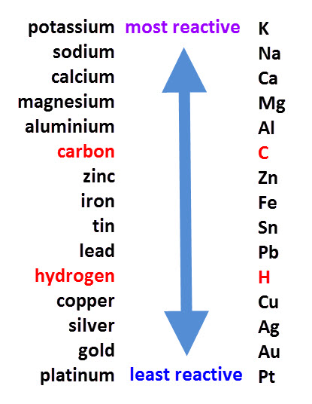
Use for Electrolysis: Extraction of Metals
Electrolysis is used to extract metals such as aluminium, which are more reactive than carbon.
However, this process uses a lot of energy (to melt the metal oxide and produce an electrical current) and is an expensive process.

Slide 26
Extraction of Aluminium
Read pg. 144 in your textbook.
Answer question __ on your worksheet (same as questions 1-2 in the textbook).
Why is aluminium dissolved in molten cryolite before it undergoes electrolysis?
Why do the positive electrodes have to be replaced over time?

Slide 27
L5 Electrolysis of Molten Ionic Compounds
Learning Objectives:
Draw a labelled diagram of equipment needed for electrolysis.
Explain why molten or aqueous ionic compounds conduct electricity.
Describe the process of electrolysis.
Predict the products of electrolysis at each electrode.
Write half equations for the reactions at each electrode.
Explain how electrolysis can be used to extract reactive metals.

Slide 28
Homework
Complete application questions on pg. 143 of your textbook.

