Slide 1
Chemistry Unit 1 Revision

Slide 2
Atomic Structure

Slide 3
The atom: check it out!
Draw a labelled diagram of the atom showing the nucleus and labelling protons, neutrons and electrons.
nucleus
electron
neutron
proton

Slide 4
Properties of subatomic particles
There are two properties of subatomic particles that are especially important:
1. Mass
2. Electrical charge
Particle | Mass | Charge
proton | 1 | +1
neutron | 1 | 0
electron | almost 0 | -1
The atoms of an element contain equal numbers of protons and electrons and so have no overall charge.

Slide 5
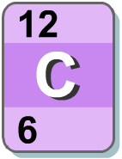
The sum of the protons and neutrons in an atom’s nucleus is the mass number.
The number of protons in an atom is known as its atomic number or proton number.

Slide 6
Calculating numbers of protons, neutrons, electrons
Protons = atomic number
Neutrons = mass number – atomic number
Electrons = same as number of protons
In a neutral atom (with no overall charge) the number of electrons (-1) and protons (+1) is equal so the charges balance out.

Slide 7
Isotopes
An isotope is an atom with a different number of neutrons:
Notice that the mass number is different. How many neutrons does each isotope have?
16
17
18
O
O
O
8
8
8
Each isotope has 8 protons – if it didn’t then it just wouldn’t be oxygen any more.

Slide 8
How many electrons per shell?
Each shell has a maximum number of electrons that it can hold. Electrons will fill the shells nearest the nucleus first.
1st shell holds a maximum of 2 electrons
2nd shell holds a maximum of 8 electrons
3rd shell holds a maximum of 8 electrons

Slide 9
Summary: the atom so far
The nucleus is:
Dense – it contains nearly all the mass of the atom in a tiny space.
Made up of protons and neutrons.
Positively charged because of the protons.
Electrons are:
Thinly spread around the outside of the atom.
Very small and light.
Negatively charged.
Found orbiting the nucleus in layers called shells.
Able to be lost or gained in chemical reactions.

Slide 10
History of the Models of Atomic Structure

Slide 11
Democritus’s Atomic Theory
1. All matter consists of invisible particles called atoms (from the Greek “Atomos” for indivisible).
2. Atoms are indestructible.
3. Atoms are solid but invisible.
4. Atoms are homogenous.
5. Atoms differ in size, shape, mass, position, and arrangement.

Slide 12
John Dalton’s Theory
All matter is made up of atoms
All atoms of the same element are identical. All atoms of different elements are different
Atoms can not be created nor destroyed only rearranged. (law of conservation of matter)
Atoms combine in fixed ratios to form compounds. (law of definite proportions)
Atoms combine in different ratios to form different compounds. (law of multiple proportions)

Slide 13
J.J. Thomson’s Experiment: Discovery of the Electron
Using a cathode ray tube, he projected a beam of particles through a magnetic field and observed how they were deflected.

Slide 14
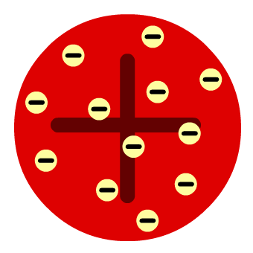
The plum pudding model
The atom is a positively-charged sphere with negative electrons distributed throughout it.

Slide 15
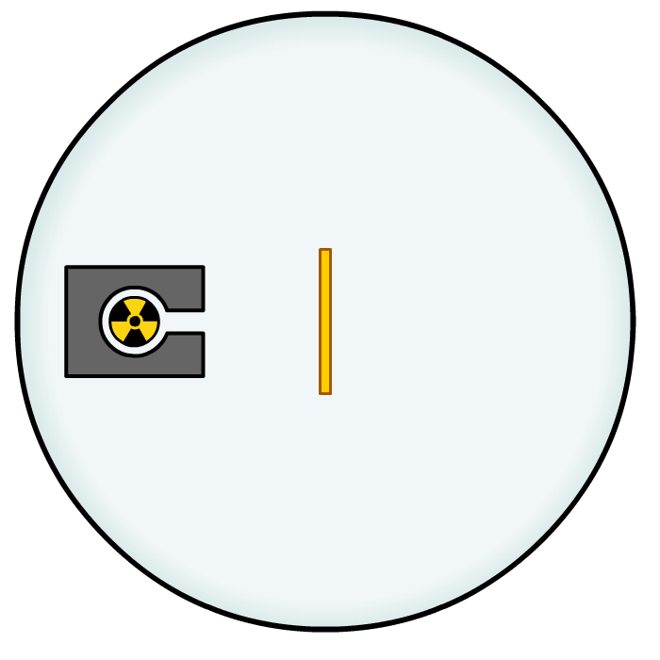
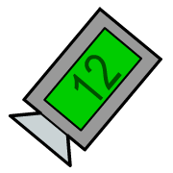
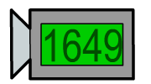
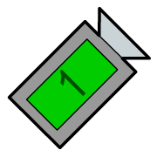
Rutherford’s Alpha Scattering Experiment
Lead box: absorb radiation and prevent it going in all directions
Radiation detector (microscope and detector plate): to count the number of alpha particles deflected to each location (historically they manually counted flashes of light on a screen)
Radiation source: source of alpha particles
Container in a vacuum: no atoms inside to interfere with the experiment
Gold foil: contain the atoms being tested on

Slide 16
The results
A beam of alpha particles (positively charged) were directed at a piece of gold foil.
The results of Geiger and Marsden’s experiment were:
2. Some alpha particles were slightly deflected by the gold foil.
1. Most alpha particles
went straight through
the gold foil, without
any deflection.
3. A few alpha particles were bounced back from the gold foil.

Slide 17
Conclusions from Rutherford’s experiment
The atom was mostly empty space.
Most of the mass was concentrated in a dense nucleus.
The nucleus was positively charged.
Electrons existed in an area surrounding the nucleus.

Slide 18
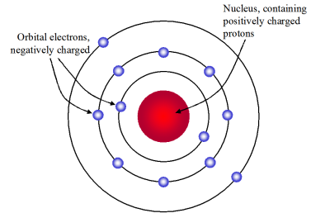
Niels Bohr
Niels Bohr used calculations to show that electrons travel in discrete orbits with specific amounts of energy.
These were later called electron shells or energy levels.

Slide 19
James Chadwick: Discovery of the Neutron
Along with other scientists, Chadwick realized the atomic mass of an element, was often twice what it should be.
This led to Chadwick conducting an experiment that proved the existence of neutrons.
It was the last to be discovered because neutrons have no charge and so are more difficult to detect.

Slide 21
The periodic table

Slide 22
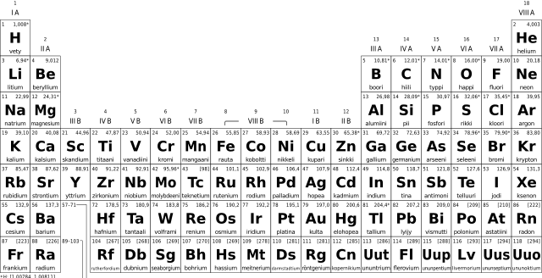
Group
1
Group
4
Group
6
Group
8 (0)
Group
2
Groups (Columns)
Group
3
Group
5
Group
7

Slide 23
Periods (Rows)
Period
1
Period
2
Period
3
Period
4

Slide 24
Charge +1
Charge
0
Charge
+2
Groups (Columns)
Charge
-1

Slide 25
Alkali Metals
Alkaline Earth Metals
Noble Gases
Halogens
Transition Metals

Slide 26
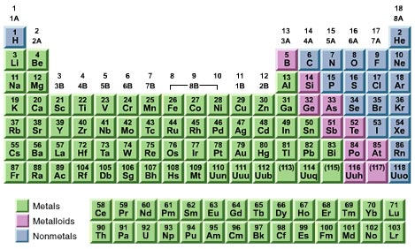
Metals vs. Non-Metals

Slide 27
History of the Periodic Table
Historically, scientists arranged the periodic table by weight.
Some scientists noticed patterns but the groups they made did not always fit the pattern.
Mendeleev’s development was that he organised the groups by properties and left spaces for elements that had not been discovered yet. This organised the table and he was able to predict the properties of undiscovered elements.

Slide 28
Metals
The majority of elements are metals.
They are located on the bottom left of the periodic table.
Physical Properties:
Good conductors
Malleable
High melting/boiling pts
High density
Lustrous (shiny)

Slide 29
Metals
Chemical Properties
Metals have very few electrons in their outer shell.
They lose these outer electrons to become stable. (Full shell = stable)
When they lose electrons there are now more protons (+) than electrons (-).
Metals form positive (+) ions.

Slide 30
 | Metals | Non-Metals
Location on Periodic Table | Bottom left of periodic table | Top right of the periodic table
State of Matter | Solid at room temp | Most are gases
MP/BP | High melting/boiling pts | Low melting/boiling pts
Physical Properties | Good conductors | Poor conductors
 | Malleable | Brittle (solids)
Chemical Properties | Form positive ions | Form negative ions (or do not form ions)
 | Lose electrons | Gain or share electrons

Slide 31
Noble Gases Summary
The elements in Group 0 of the periodic table are called the noble gases.
They are unreactive and do not easily form molecules because their atoms have stable arrangements of electrons.
The noble gases have eight electrons in their outer energy level, except for helium, which has only two electrons.
The boiling points of the noble gases increase with increasing relative atomic mass (going down the group).

Slide 32
Alkali Metals Summary
The elements in Group 1 of the periodic table, known as the alkali metals.
Are metals with low density (the first three are less dense than water)
React with non-metals by losing 1 electron to form positive ions (+1 charge)
Reaction with water gives off hydrogen gas and a metal hydroxide (OH)
Alkali Metal + Water → Hydrogen + Alkali Metal Hydroxide
The alkali metal hydroxide are white solids that dissolve to form alkaline solutions.
The reactivity increases as you go down the group. This is because the farther away the electron is from the nucleus, the easier it is to remove.

Slide 33
Halogens Summary
The elements in Group 7 of the periodic table, known as the halogens.
They are non-metals. Fluorine and chlorine are gases, bromine is a liquid, and iodine is a solid.
They are all diatomic molecules (found in pairs).
React with metals by gaining one electron and forming negative ions (-1 charge).
The melting and boiling points increases down the group.
The reactivity decreases as you go down the group. This is because the farther away the electron is from the nucleus, the more difficult it is to attract.

Slide 34
Atoms, Elements, Compounds, Mixtures

Slide 35
Key Terms
Atom = smallest unique particle of matter
Element = all the atoms of an element are the same
Molecule = two or more atoms chemically joined (can be the same type or different)
Compound = two or more atoms of different elements chemically joined
Mixture = two or more elements or compounds not chemically joined

Slide 36
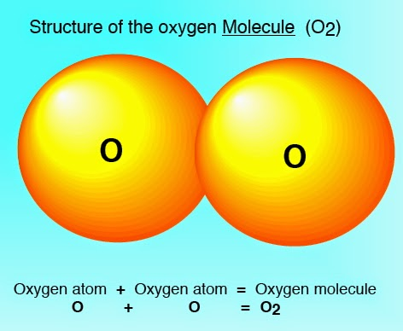
When atoms are chemically bonded together they are called molecules
Some elements exist as atoms, but some exist as molecules
The atoms can only be separated when a chemical reaction takes place

Slide 37
Compounds
H
Compounds are a special type of molecule.
Compound = two or more atoms of different elements chemically joined
Example: Methane (CH₄)
Molecule
Also a compound
H
C
H
H
A MOLECULE OF THE COMPOUND METHANE

Slide 38
molecules
If the atoms are the same
then it is a molecule of an
element eg H₂ -hydrogen
If the atoms are different
then it is a molecule of a
compound eg CH₄ methane

Slide 39
Name the following compounds: Metal + Non-metal
LiCl
CaF₂
KBr
BaO
MgCO₃
ZnSO₄
ZnSO₃
WCl₃
AlPO₄
NaNO₃
Lithium Chloride
Calcium Fluoride
Potassium Bromide
Barium Oxide
Magnesium Carbonate
Zinc Sulphate
Zinc Sulphite
Tungsten Chloride
Aluminium Phosphate
Sodium Nitrate
Notes:
Students should try to name these on their own to check their understanding

Slide 40
Name the following compounds: Non-metal + non-metal
CO
SF₆
SO₂
SiCl₄
P₄O₁₀
NH₃
PBr₅
PCl₃
SiO₂
XeF₆
Carbon Monoxide
Sulphur Hexafluoride
Sulphur Dioxide
Silicon Tetrachloride
Tetraphosphorus Decaoxide
Nitrogen Trihyride
Phosphorous Pentabromide
Phosphorous Trichloride
Silicon Dioxide
Xenon Hexafluoride
Notes:
Students should try to name these on their own to check their understanding

Slide 41
Mixtures
This is when elements and compounds are just mixed together .
Mixtures can be separated using physical changes
Air is a mixture of different gases.
Oxygen, nitrogen, argon, carbon dioxide and water vapour are all in the air.

Slide 42
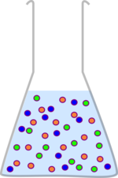
A mixture consists of two or more elements or compounds not chemically combined together.
The chemical properties of each substance in the mixture are unchanged.
Mixtures can be separated by physical processes (NO chemical reactions involved).

Slide 43
Separation Techniques
Filtration
Crystallisation
Distillation
Fractional Distillation
Chromatography

Slide 44
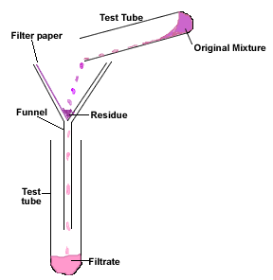
Filtration
Separates: insoluble solids from a liquid
Physical Property: solubility
How does it work:
Filter paper contains small holes that allow water molecules and soluble particles to pass through (filtrate).
Insoluble solids have atoms which are still bonded together in a large molecule that cannot pass through the holes and is trapped by the filter paper (residue).
Residue =
Insoluble solid
Filtrate =
Filtered liquid

Slide 45
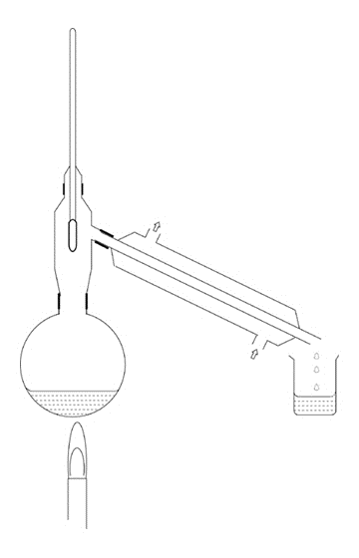
Distillation
Separates: liquid from a solution or mixture of two liquids
Physical Property: boiling point
How does it work:
Mixtures is heated to the boiling point of one liquid (but not hot enough to boil the second).
The liquid evaporates and enters the condenser.
The condenser cools the gas back into a liquid to be collected (distillate).
Thermometer
Condenser
Mixture
Distillate =
Pure Liquid
Heat source

Slide 46
Fractional Distillation
Separates: multiple liquids from a mixture
Physical Property: boiling point
How does it work: METHOD 1
Mixtures is heated to the boiling point of liquid 1 (but not hot enough to boil the second).
The liquid evaporates and enters the condenser.
The condenser cools the gas back into a liquid to be collected.
Heat the mixture further to the boiling point of liquid 2 and repeat.
Notes:
http://www.rsc.org/learn-chemistry/wiki/Expt:The_fractional_distillation_of_crude_oil

Slide 47
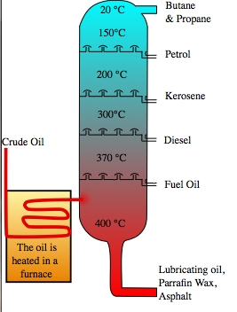
Fractional Distillation
How does it work: METHOD 2
Heat the mixture at a high temperature until ALL liquids evaporate.
The column is hotter at the bottom, cooler at the top.
Liquids cool and condense at different locations with different temperatures (relating to their boiling points)
Each liquid mixture obtained is called a fraction.
Fractions = mixtures collected at different temperatures

Slide 48
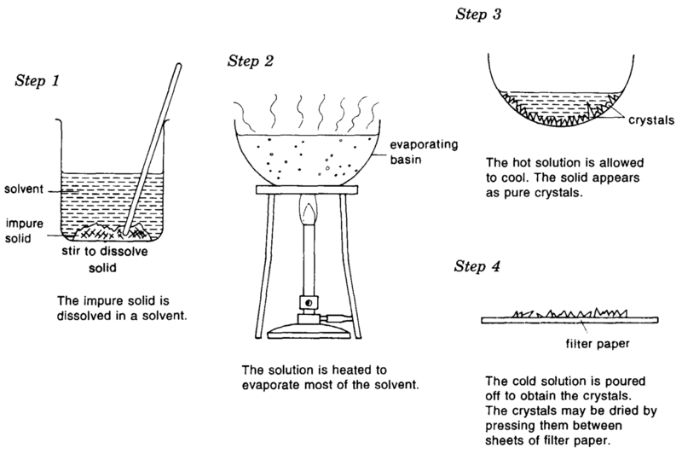
Crystallisation
Separates: soluble solids from a solution
Physical Property: solubility
How does it work:
Evaporating a liquid from a solution will produce a supersaturated solution (there is more solute in the solution than the solubility limit).
Once the solution cools, the solid cannot stay in solution past it’s solubility limit and crystallises.

Slide 49
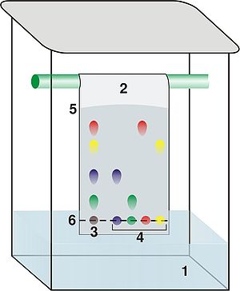
Chromatography
Chromatogram = result showing the separation of the coloured substances
Separates: dyes from a mixture of dyes
Physical Property: solubility and interaction with paper molecules
How does it work:
A spot of the mixture of dyes is placed on chromatography paper (draw a pencil line).
Only the very bottom of chromatography paper is dipped into a solvent (usually water).
Paper absorbs the solvent and carries the dyes up the paper.
Different molecules will interact with the solvent and paper different amounts so will travel different distances up the paper.

