Slide 1
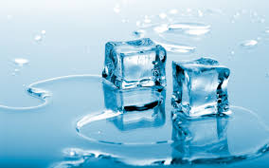
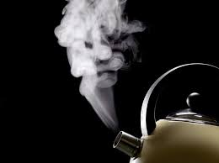
Ice
Water
Steam

Slide 2
Lesson Objectives
Properties of solids, liquids and gases
Recall the three states of matter
To describe the different properties of solids, liquids and gases
To classify substances as one of the three states of matter based on their properties
Introduce density

Slide 3
The 3 States of matter
We can classify materials as either:
Solid Liquid Gas
How many of each can you list?

Slide 4
The 3 States of matter
Classify (sort) the objects you have been given into solids, liquids and gases, and record it in your book.
Think about the properties of each state and fill in the next table as you do the practical

Slide 5
 | Solid | Liquid | Gas
A. Fixed shape? | YES | NO | NO
B. Fixed volume? | YES | YES | NO
C. Can be squashed? | NO | NO | YES
D. Does it flow? | NO | YES | YES
E. Heavy or light? | Heavy | Medium | Light

Slide 6
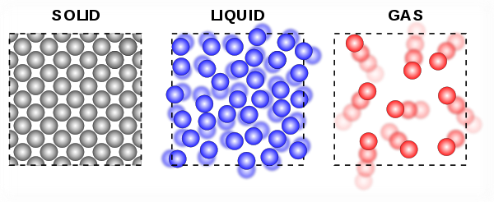
Regular pattern and closely packed.
Vibrate in fixed position.
Strong force of attraction holds them tight together.
Random arrangement but close together.
Slide over one another and changing places.
Weak force of attraction between particles.
Random arrangement and far apart.
Rapid, in all directions.
Very weak force of attraction between particles.

Slide 7
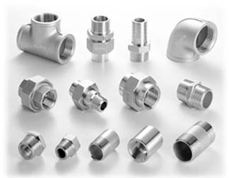
Solid
A solid has a fixed shape, a fixed volume, and can NOT be squashed.

Slide 8
Solid
A solid has a fixed shape, a fixed volume, and can NOT be squashed.

Slide 9
Liquid
A liquid has NO fixed shape, but has
a fixed volume, and can NOT be squashed.

Slide 10
Liquid
A liquid has NO fixed shape, but has
a fixed volume, and can NOT be squashed.

Slide 11
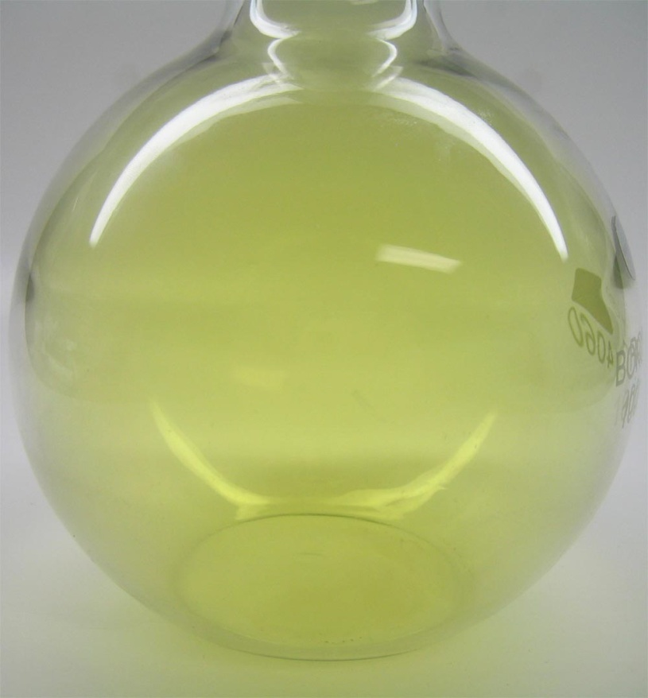
Gas
A gas has NO fixed shape, NO fixed volume, and can be squashed.

Slide 12
Gas
A gas has NO fixed shape, NO fixed volume, and can be squashed.

Slide 13
Density
Which is heavier, a kilo of feathers or a kilo of steel
How heavy something is for its size
A brick and sponge are about the same size, but the brick is more dense as it has a bigger mass than the sponger
Solids are denser than liquids which are denser than gases, as the particles are closer together

Slide 14
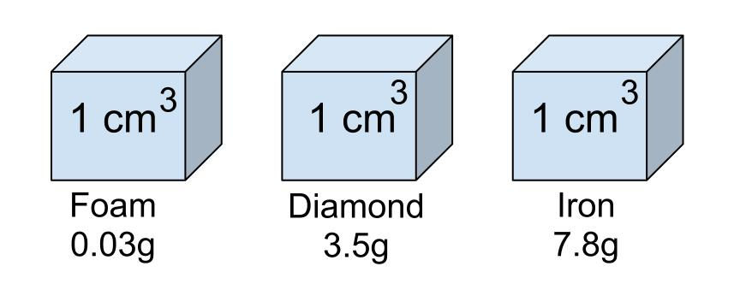
Which is heavier?
Which is denser? Why?

Slide 15
Homework
Learn spellings and definitions of keywords for this topic

Slide 16
Plenary
Can you walk on custard??? (4.00 min)

