Slide 1
L9 Fractional Distillation and Cracking
Learning Objectives:
Describe the process of fractional distillation.
Describe the process of cracking crude oil.
Explain the purpose of fractional distillation and cracking.

Slide 2
Write down as many ideas as you can remember about crude oil.
Crude Oil
?
?
?
?

Slide 3
Crude Oil
Is a mixture of hydrocarbons (made of hydrogen and carbon only).
Hydrocarbons are different lengths, different number of carbons in the chain.
Some hydrocarbons can be used as fuels.
Can be separated based on boiling point.

Slide 4
Hydrocarbons – Alkanes (single bonded)
No. of Carbons | Name | Formula | Structure
1
2
3
4
5
n | x |  | x

Slide 5
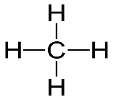
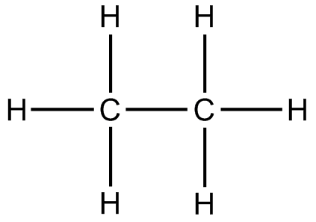
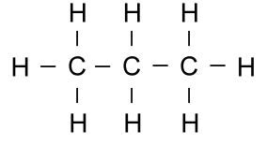
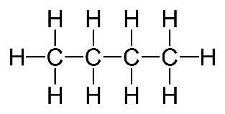
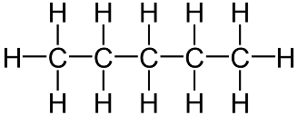
Hydrocarbons – Alkanes (single bonded)
No. of Carbons | Name | Formula | Structure
1 | Methane | CH₄
2 | Ethane | C₂H₆
3 | Propane | C₃H₈
4 | Butane | C₄H₁₀
5 | Pentane | C₅H₁₂
n | x | C_{n}H_{2n+2} | x

Slide 6
Fuels
What are the properties of a good fuel?
What type of hydrocarbons are good fuels?

Slide 7
Fuels
What are the properties of a good fuel?
Highly flammable
Releases a lot of energy
Complete combustion
Easy to transport
What type of hydrocarbons are good fuels?
Shorter length hydrocarbons

Slide 8
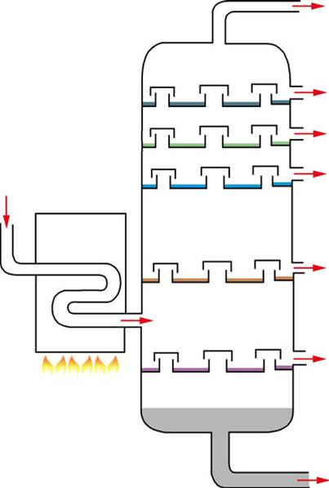
Fractional Distillation
Label the diagram
Crude Oil (mixture)
Fractionating Column
Furnace
Coldest location
Hottest location
Shortest hydrocarbons
Longest hydrocarbons
Fractions

Slide 9
Fractional distillation (step by step)
Choose the difficulty for this task.
Write out the step by step method from memory.
Write out the step by step method using a word bank.
Fill in the blanks of a step by step method from memory.
Fill in the blanks of a step by step method using a word bank.
Put a step by step method in the correct order.

Slide 10
Fractional Distillation
Crude oil, a mixture of hydrocarbons, enters the furnace.
All the hydrocarbons are vaporised.
The hot gas mixture is pumped into the fractionating column.
The hot gases rise up the column.
It is hottest at the bottom and coldest at the top.
Each hydrocarbon has a different boiling point.
Once rises so much that it is colder than the boiling point, the fraction condenses back into liquid and pumped out of the column.
The rest of the mixture continues to rise until each fraction has condensed and been removed at a different place up the column.

Slide 11
Why is fractional distillation important?
Crude oil is a mixture of hydrocarbons.
It CANNOT be used as a mixture.
Each fraction has different properties and different uses.
Useful fuels are the lighter fractions (top of the column).
Heavy fractions (bottom) are less useful

Slide 12
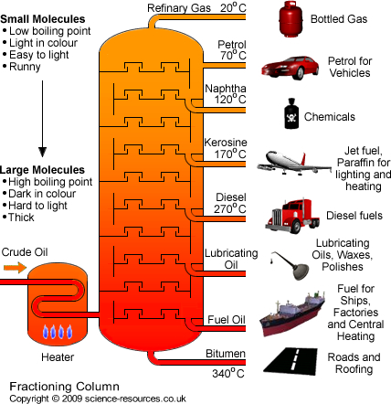
(Gas Stoves)
(Bunsen burners)

Slide 13
Which fractions are in the highest demand?
Analyse the data, what conclusions can you make?

Slide 14
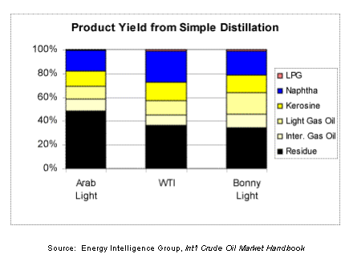
Fractional Distillation alone CANNOT meet the demand for fuels

Slide 15
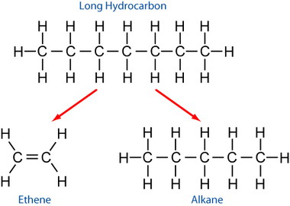
Cracking
Cracking is a process where we break long chain alkanes into shorter chain alkanes and a second product, an alkene.
Count up the carbons and hydrogens before and after.
They should always be equal.

Slide 16
Practice Exam Question
Complete the reaction for the cracking of decane.

Slide 17
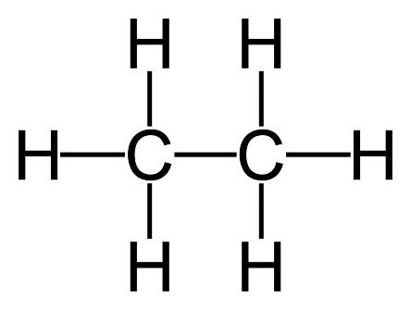
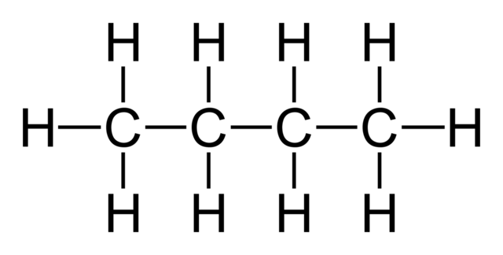
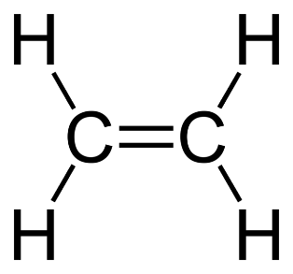
Alkanes vs Alkenes
Alkanes are hydrocarbons that contain only single bonds.
Alkenes are hydrocarbons that contain a double bond.
ETHANE
BUTANE
ETHENE
BUTENE

Slide 18
Hydrocarbons – Alkenes (double bonded)
No. of Carbons | Name | Formula | Structure
1 | x | x | x
2
3
4
5
n | x |  | x

Slide 19
Hydrocarbons – Alkenes (double bonded)
No. of Carbons | Name | Formula | Structure
1 | x | x | x
2 | ethene | C₂H₄
3 | propene | C₃H₆
4 | butene | C₄H₈
5 | pentene | C₅H₁₀
n | x | C_{n}H_{2n} | x

Slide 20
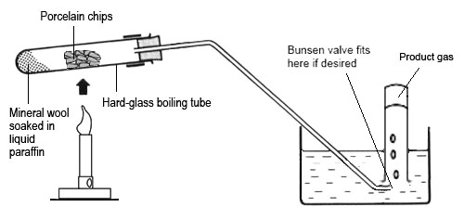
Cracking in the lab
2. The gas passes over the catalyst (speeds up reaction).
3. Hydrocarbon “cracks” into short alkane and alkene
5. Alkene gas can be tested
4. Products flow through tube into test tube
1. Apply heat to long alkane and turns to gas

Slide 21
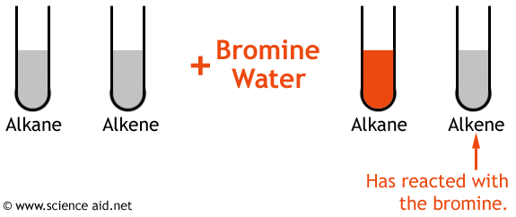
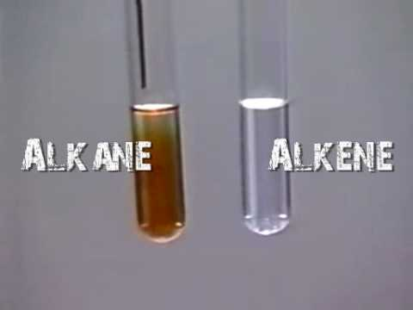
Test for Alkenes
To test to see if a sample actually contains alkenes we add bromine water.
Bromine water is usually orange.
If the bromine water goes from orange to colourless, the sample has alkenes in it.

Slide 22
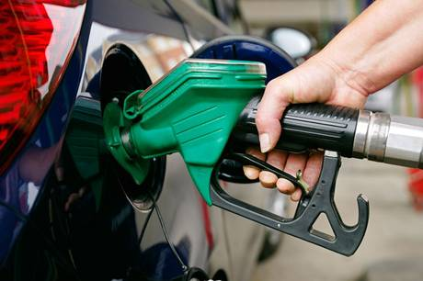
Why is cracking important?
Cracking allows us to turn useless heavy fractions into useful fuels.
If we did not crack long chain hydrocarbons, we would not be able to meet the demand for fuels such as petrol.

