Slide 1
L3: Titrations
Learning Objectives:
Required Practical 1:
Make up a volumetric solution.
Carry out a simple acid-base titration.
Calculate concentration using titration results.

Slide 2
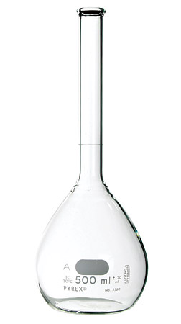
Making up a volumetric solution
Decide on volume and concentration.
Calculate number of moles.
Calculate mass.
Measure out mass of substance.
Dissolve in correct volume of water using a volumetric flask.
NOTE: Be careful! It is very easy to over shoot!

Slide 3
Acid-Base Titration
An unknown concentration or volume of either acid or base can be determined through a titration using a neutralisation reaction with either a base or acid with a known concentration and measure the volume needed to neutralise.
Example:
HCl + NaOH → NaCl + H₂O

Slide 4
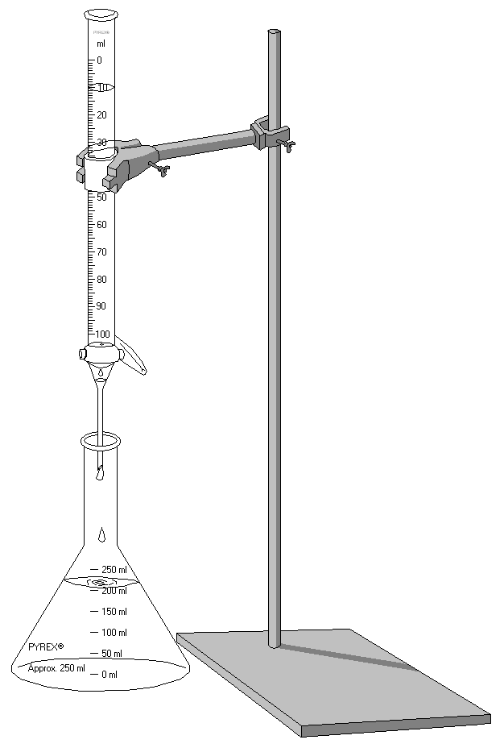
Acid-Base Titration
Set Up
Choose appropriate titrant of known concentration.
Set up, rinse the burette with the titrant, and refill. Remove funnel!
Measure a set volume of the analyte using a pipette into a conical flask.
Rinse the pipette and the sides of the conical flask into the flask with deionized water.

Slide 5
Titration
Add a few drops of an appropriate indicator into the conical flask.
Open the stopcock and allow the titrant to flow into the conical flask.
Constantly swirl the solution to mix.
Watch for a colour change.
Begin adding the titrant dropwise when nearing the end point. Rinse with water any drops on the side of the flask.
Stop just at the colour change.

Slide 6
Recording Results
Titre = the volume of titrant needed to neutralise the analyte
Concordant results (titrations) = results within 1 cm³ of each other
Record the initial volume of titrant in the burette. Round to the nearest 0.1 cm³
Record the final volume of titrant in the burette.
Subtract the final volume from the initial volume to calculate the titre.
Repeat titrations until you have three concordant results
Calculate the average titre using only the concordant results. Don’t round your result, only round to correct number of s.f. after your final calculation of concentration.

Slide 7
Initial | Final | Titre (cm³)
50.0 | 35.6 | 14.4
35.6 | 21.7 | 13.9
21.7 | 7.4 | 14.3
41.2 | 36.8 | 14.4
36.8 | 22.6 | 14.2
 |  | Average = 14.367

Slide 8
Analysing Results
Write a balanced equation for the neutralisation reaction.
Average titre is volume of titrant, convert to dm³. Concentration of titrant is known.
Calculate the number of moles of the titrant.
Using molar ratios calculate the number of moles of the analyte.
Using moles and volume, calculate the concentration of the analyte.

Slide 9
Example: 25.0 cm³ of 0.500 mol dm⁻³ of HCl neutralised 35.0 cm³ of NaOH of unknown concentration.
HCl + NaOH → NaCl + H₂O
Concentration = 0.500 mol dm⁻³ volume HCl = 25.0 cm³ / 1000 = 0.025 dm³
Concentration = $\frac{moles}{volume}$ moles = conc. x volume = 0.500 x 0.025 = 0.0125 moles
HCl:NaOH = 1:1 0.0125 moles HCl = 0.0125 moles NaOH
volume NaOH = 35.0 cm³ / 1000 = 0.035 dm³
Concentration = $\frac{moles}{volume}$ = $\frac{0.0125 mole}{0.035 dm3}$ = 0.357 mol dm⁻³ (3 s.f.)

Slide 10
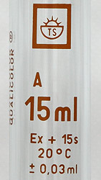
Error and Uncertainty
Each piece of equipment has a different error or uncertainty value.
These are written as ± values.
Example: the pipette on the right has an error value of ± 0.03 cm³.

Slide 11
Error and Uncertainty (Titrations)
The burettes we are using have an error value of ± 0.05 cm³.
In titrations, we take two measurements, initial volume and final volume.
The error values are added together, the total error for a titration is ± 0.10 cm³. We can then work out percentage error for our measurement.
Percentage error = $\frac{error}{reading (titre)}$ x 100 = $\frac{0.10 cm3}{14.40 cm3}$ x 100 = 0.69 % uncertainty

Slide 12
Homework:
Revise Section 2.5 (pg. 49-53)
Complete Q2 on pg. 52 and pg. 53, if you haven’t already done so.
Pay close attention to practical skills.

