Slide 1
Acids, Bases, and Buffers
Defining an Acid
pH Scale
Finding the pH of weak acids and bases
Acid-Base titrations
Choice of indicators for titrations
Buffer solutions

Slide 2
Defining an acid
Learning Objectives:
Describe a Bronsted-Lowry acid and base.
Describe what happens in Bronsted-Lowry acid-base reactions.
Describe how water acts as an acid and a base.
Understand the expression for the ionic product of water (K_{w})

Slide 3
Bronsted-Lowry Acid and Base Definitions
Acid – substance that donates a proton (H⁺)
Base – substance that can accept a proton
(Alkali – a water soluble base producing OH⁻ ions)
Examples:
Acids: HCl, H₂SO₄, HNO₃
Bases: NaOH, NH₃

Slide 4
The Hydroxonium Ion
H⁺ ions do not exist on their own.
They are always attached to a water molecule.
Forming a hydroxonium ion H₃O⁺
For simplicity purposes we will write out H⁺ but just remember that this does not exist in this form.

Slide 5
Equilibrium
The dissociation of acids is a reversible reaction in equilibrium.
HA H⁺ + A⁻
For strong acids, the equilibrium lies heavily to the right.
HCl H⁺ + Cl⁻
For weak acids, the equilibrium lies heavily to the left.
CH₃COOH H⁺ + CH₃COO⁻

Slide 6
Acids and Bases react in pairs
A Bronsted-Lowry acid-base reaction involves a proton transfer.
HA + B HB⁺ + A⁻
Examples:
HCl + NH₃ → NH₄⁺ Cl⁻
H₂SO₄ + HNO₃ → H₂NO₃⁺ + HSO₄⁻

Slide 7
Water as an acid and a base
Water can both donate and accept protons, so can act as both a Bronsted-Lowry acid and base.
HCl + H₂O → H₃O⁺ + Cl⁻
H₂O + NH₃ → NH₄⁺ + OH⁻

Slide 8
Ionisation of water
Water is ionised as it partially dissociates:
H₂O H⁺ + OH⁻
H₂O + H₂O H₃O⁺ + OH⁻
Water is a very weak acid/base so only partially dissociates.
The equilibrium lies heavily to the left and it is assumed that the concentration of water remains constant.

Slide 9
Ionic Product of Water (K_{w})
An equilibrium is established, with a K_{c} expression as follows:
Because [H₂O] is assumed to be a constant, we modify the expression to get a new expression, where K_{w} = K_{c} x [H₂O]

Slide 11
Ionic Product of Water (K_{w})
Since H₂O H⁺ + OH⁻
For every water molecule, one H+ ion and one OH- ion is produced.
So we can use the expression
K_{w} = [H⁺][OH⁻]
K_{w} = [H⁺]²

Slide 12
The pH Scale
Learning Objectives:
Define pH.
Use the pH to find the concentration of H⁺ and OH⁻ ions.
Calculate pH from concentration of ions.

Slide 13
pH scale
pH = -log₁₀[H⁺]
Why is a logarithmic scale used?
Because the [H+] varies so greatly the logarithmic scale helps us to use numbers that are more manageable.
What does this mean?
This means that a pH of 2 is 10X more acidic than a pH of 3.

Slide 14
Try this out, Calculating pH from [H⁺]
pH = -log[H⁺]
Calculate the pH for the following [H⁺] to see how this works:
1.0 x 10 ⁻¹ mol dm⁻³
1.0 x 10 ⁻⁷ mol dm⁻³
1.0 x 10 ⁻¹⁴ mol dm⁻³
As [H⁺] increases, the pH…

Slide 15
Review logs

Slide 16
K_{w} changes with temperature, so pH of water also changes with temperature
T (°C) | K_{w} (mol² dm⁻⁶) | pH
0 | 0.114 x 10⁻¹⁴ | 7.47
10 | 0.293 x 10⁻¹⁴ | 7.27
20 | 0.681 x 10⁻¹⁴ | 7.08
25 | 1.008 x 10⁻¹⁴ | 7.00
30 | 1.471 x 10⁻¹⁴ | 6.92
40 | 2.916 x 10⁻¹⁴ | 6.77
50 | 5.476 x 10⁻¹⁴ | 6.63
100 | 51.3 x 10⁻¹⁴ | 6.14

Slide 17
Calculating [H⁺] from pH

Slide 18
Calculating [OH⁻] (extra step)

Slide 19
pH of STRONG acids
For strong acids we make the assumption
STRONG ACIDS DISSOCIATE COMPLETELY.
Therefore: [HA] = [H⁺]
Calculate the pH of a solution with HCl concentration of:
1.00 mol dm⁻³
0.160 mol dm⁻³
0.050 mol dm⁻³

Slide 20
Calculate the pH of a solution with HCl concentration of:
1.00 mol dm⁻³ → pH 0.00
0.160 mol dm⁻³ → pH 0.80
0.050 mol dm⁻³ → pH 1.30

Slide 21
Diprotic Acids
Some acids when they dissociate will form 2H⁺ ions.
These acids are called diprotic acids.
H₂SO₄ → 2H⁺ + SO₄⁻
1 H₂SO₄ molecule = 2H⁺ ions
2[H₂SO₄] = [H⁺ ]

Slide 22
pH of STRONG bases
We make a similar assumption for bases, they dissociate fully.
NaOH → Na⁺ + OH⁻
Therefore… [NaOH] = [OH⁻]
We can then use the Kw equation to solve for [H⁺]
K_{w} = [H⁺][OH⁻]

Slide 23
Calculate the pH of alkaline solution
[NaOH] =
1.00 mol dm⁻³
0.100 mol dm⁻³
0.200 mol dm⁻³
a) 14
b) 13
c) 13.30

Slide 24
Practice
Answer the Application Questions on pg. 101

Slide 25
Finding the pH of weak acids and bases
Learning objectives:
Describe what is meant by the term “weak acid” or “weak base”
Write an expression of the acid dissociation constant, K_{a}
Calculate the pH of weak acids and weak bases

Slide 26
Weak acids and bases dissociation equilibrium
HA H⁺ + A⁻
Equilibrium expression
K_{c} = $\frac{\left[H+\right][A−]}{[HA]}$

Slide 27
Just another constant…
For weak acids this is given the symbol K_{a}
So…
K_{a} = $\frac{\left[H+\right][A−]}{[HA]}$

Slide 28
Calculating the pH of weak acids
This is very similar to our equilibrium calculations from before
Calculate the pH of 1.00 mol dm⁻³ ethanoic acid.
CH₃COOH CH₃COO⁻ + H⁺
Start 1.00 0 0
Eqm 1 – [CH₃COO⁻] [CH3COO⁻] [H⁺]

Slide 29
New assumptions
1) For each CH₃COOH that dissociates, 1 CH₃COO⁻ and 1 H⁺ are produced
Therefore: [CH₃COO⁻] = [H⁺]
2) Then 1 [CH₃COO⁻] = 1 [H⁺]
3) For weak acids the dissociation is so small that 1.00 – [H⁺] = ~ 1.00

Slide 30
So…using the K_{a} expression
K_{a} = $\frac{\left[CH3OO−\right][H+]}{1.00−[CH3COO−]}$
This simplifies (from our assumptions) to…
K_{a} = $\frac{\left[H+\right]2}{1.00}$
Then we look up the K_{a}, plug it in, and solve for [H⁺]

Slide 31
Now you try it!
Find the pH of a 0.020 mol dm⁻³ solution of propanoic acid (CH₃CH₂COOH) at 298 K. K_{a} for this temperature is 1.30 x 10⁻⁵ mol dm⁻³.
3.29

Slide 32
We can also work backwards
The pH of an ethanoic acid solution (CH₃COOH) is 3.02 at 298 K. Calculation the concentration of this solution. The K_{a} of ethanoic acid is 1.75 x 10⁻⁵ mol dm⁻³ at 298 K.
(HINT: the inverse of log is 10^{x}).
5.21 x 10⁻² mol dm⁻³

Slide 33
pK_{a} (it’s like pH)
K_{a} numbers can vary greatly depending on the acid, so to make things easier and use more manageable numbers scientists often use pKa to compare acids easily.
pK_{a} = -log₁₀(K_{a})
The smaller the pKa is, the stronger the acid is (just like pH)
Just to make your life harder, sometimes pH calculations give you pK_{a} and you have to convert into K_{a} to solve.

Slide 34
Practice
Answer the application questions on pg. 105

Slide 35
Acid-Base Titrations
Learning Objectives:
Understand the uses of titrations
Identify and describe the shapes for pH curves for titrations
Describe the equivalence point of a titration

Slide 36
Reminder: Titrations are used to experimentally determine the amount of acid or alkali
Acid (of known concentration) is added or an alkali (or alkali can be added to acid) until an indicator shows that the alkali has been completed neutralised.
The amount of alkali (or acid) can then be calculated using the amount of the known acid (or alkali).

Slide 37
Titration curves (pH curves)
pH curves show the results of titration experiments.
X-axis = volume of titre
Y-axis = pH
The shape of the curve looks different depending on the strengths of the acid or alkali.

Slide 38
pH curves

Slide 39
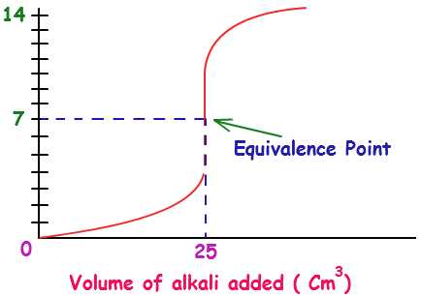
Equivalence Point
Equivalence point is when the moles of alkali = the moles of (initial) H⁺
This is represented by the vertical portion of the titration curve

Slide 40
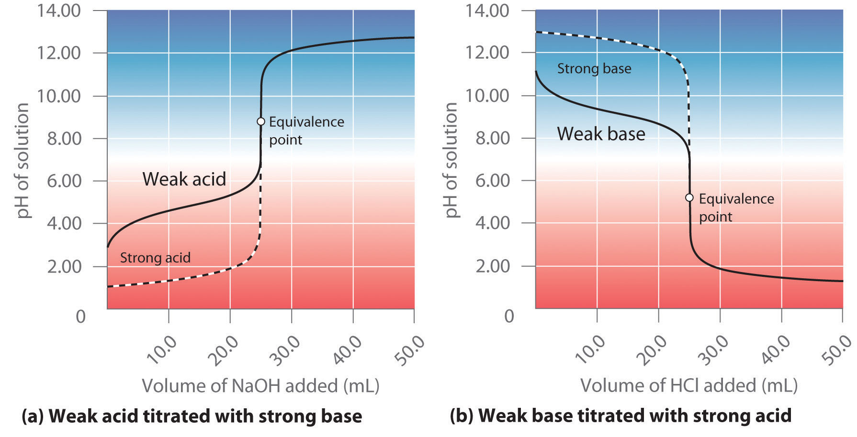
Equivalence point DOES NOT always = pH 7

Slide 41
Review: working out concentrations
In a titration, we find that the equivalence point is reached when 25 cm³ of 0.0150 mol dm⁻³ sodium hydroxide is neutralised by 15.0 cm³ hydrochloric acid. What is the concentration of the acid?

Slide 43
Diprotic acids: Don’t forget the ratio!
In a titration we find that the equivalence point is reached when 20 cm³ of 0.0100 mol dm⁻³ sodium hydroxide is neutralised by 15.0 cm³ of sulphuric acid. What is the concentration of the acid?

Slide 45
Practice
Answer the application questions on pg. 112-113.

Slide 46
Choice of indicators for titrations
Learning Objectives:
Explain how to select a suitable indicator for a titration using the titration curve
Describe the importance of the half-neutralisation point.

Slide 47
Suitable indicator must:
Sharp colour change
Distinct colour change
pH causing colour change must match the equivalence point

Slide 48
End point of a titration
End point = the volume of titrate when the indicator just changes colour
Each indicator has a slightly different pH range leading to a colour change.
This range is acceptable because the vertical region of the titration curve shows how a very small change in volume leads to a large change in pH.

Slide 49
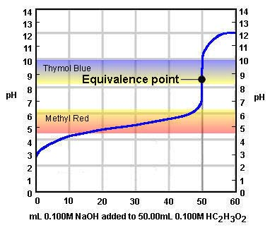
Which indicator is suitable for this titration?

Slide 50
The half-neutralisation point
The first part of a pH curve is very gently sloping, large volume changes lead to very small pH changes.
The mid-point between zero and the equivalence point is called the half-neutralisation point.
This is important because the knowledge that we can add a acid (or base) up to this point with very little change in pH is relevant to the theory of buffers.

Slide 51
Also allows us to calculate K_{a} and pKa
HA + OH⁻ → H₂O + A⁻
At half-neutralisation point
[HA] = [A⁻]

Slide 52
Practice
Answer the application questions on pg. 109

Slide 53
Buffers
Learning Objectives:
Describe what a buffer is.
Describe how buffers work.
Calculate the pH of a buffer solution.
Describe what buffers are used for.

Slide 54
What is a buffer?
Buffer = a solution that resists changes in pH when small amounts of acid or alkali are added.
It DOES NOT stop the pH from changing, but it does make the changes smaller.
Buffers only resist changes from SMALL amounts of acid or alkali.

Slide 55
How does a buffer work?
Buffers take advantage of Le Chatelier’s principle for equilibrium.
An equilibrium is set up with a weak acid or base with an excess of it’s conjugate salt.
When acid or alkali is added, it changes the concentration. This shift equilibrium which removes some of the excess H⁺ or OH⁻ ions.

Slide 56
Acidic Buffers
Made by mixing a weak acid with one of its (soluble) salts.
Example: Ethanoic acid + Sodium Ethanoate
CH₃COOH CH₃COO⁻ + H⁺
CH₃COONa → CH₃COO⁻ + Na⁺
There is now only a small amount of H⁺ concentration and a large amount of CH₃COO⁻ in solution.

Slide 57
What happens when we add acid?
CH₃COOH CH₃COO⁻ + H⁺
When acid is added what happens to this equilibrium?
[H⁺] increases, shifting equilibrium to the left to oppose the change.
There is plenty of CH₃COO⁻ (from the salt) for the reverse reaction (H⁺ combines with CH₃COO⁻).
This produces more ethanoic acid and consequently decreases the [H⁺] back to near what it was before.

Slide 58
What happens when we add alkali?
CH₃COOH CH₃COO⁻ + H⁺
What happens when we add alkali?
OH⁻ ions react with H⁺ ions in solution (OH⁻ + H⁺ → H₂O)
This decreases the [H⁺], so equilibrium shifts to the right.
There is plenty of ethanoic acid which dissociates to product more H⁺.
This then increases [H⁺] back to near what it was before.

Slide 59
Basic Buffers
Similar concept, we mix a weak base with one of its (soluble) salts.
Example: Ammonia and Ammonium Chloride
NH₃ + H₂O NH₄⁺ + OH⁻
NH₄Cl → NH₄⁺ + Cl⁻

Slide 60
What happens when you add acid?
NH₃ + H₂O NH₄⁺ + OH⁻
H⁺ reacts with OH⁻, this decreases [OH⁻]
Equilibrium shifts to the right to replace [OH⁻] that has been lost.
This increases [OH⁻] back to near original.

Slide 61
What happens when you add alkali?
NH₃ + H₂O NH₄⁺ + OH⁻
[OH⁻] increases, so equilibrium shifts to the left.
This decreases the [OH⁻] near to original.

Slide 62
Calculating the pH of acidic buffers
Write out the K_{a} expression for the weak acid.
Rearrange to solve for [H+]
Substitute in values for K_{a}, [weak acid], [salt]
Solve for [H+]
Substitute in [H+] into pH expression

Slide 63
Example:
A buffer solution contains 0.400 mol dm⁻³ methanoic acid, HCOOH, and 0.600 mol dm⁻³ sodium methanoate, HCOONa. For methanoic acid, K_{a} = 1.6 x 10⁻⁴. What is the pH of this buffer solution?

Slide 65
Try it!
A buffer consists of 0.100 mol dm⁻³ ethanoic acid and 0.100 mol dm⁻³ sodium ethanoate. K_{a} for ethanoic acid is 1.7 x 10⁻⁵, pK_{a} = 4.77. What is the pH of the buffer solution?
4.77
Note: when you have equal amounts of acid and salt, pH = pK_{a} (half-neutralisation point).

Slide 66
Another way to make buffers
Sometimes a weak acid is mixed with a little alkali. This causes some of the acid to become neutralised forming the conjugate salt and some leftover acid.
To calculate the pH of this kind of buffer, an extra step is added.
Use the equation and molar ratios to calculate how many moles of acid and salt are left after neutralisation.
Calculate concentration using the total volume.
Calculate pH as before.

Slide 67
A buffer is formed by mixing 15 cm³ of 0.1 mol dm⁻³ sodium hydroxide and 30 cm³ of 0.6 mol dm⁻³ propanoic acid (CH₃CH₂COOH). Calculate the pH of this buffer solution (K_{a} = 1.35 x 10⁻⁵ mol dm⁻³).

Slide 70
Practice
Answer questions on pg. 119

Slide 71
Calculating pH change when acid is added to an acidic buffer solution
This is similar to the equilibrium calculations.
Assumptions:
All the added H⁺ will react with the salt to form the weak acid.
So…the amount of ethanoic acid increases by amount acid added.
And…the amount of salt will decrease by the same amount.

Slide 72
Calculating pH change of an acidic buffer
1) Calculate the starting amount (moles) of acid and salt.
2) Calculate the changes in moles of the acid and the salt.
3) Calculate the concentrations of the acid and the salt.
4) Substitute into Ka expression and solve for [H+].
5) Calculate pH.

Slide 73
Calculating pH change when alkali is added to an acidic buffer solution
Assumptions:
All the added OH⁻ will react with the H+ to form water.
This pushes the equilibrium to the right (more acid dissociates to form more H+ to replace what was lost)
So…the amount of ethanoic acid decreases by amount OH⁻ added.
And…the amount of salt will increase by the same amount.

